Slide 1
Terraform Script for AWS Infrastructure Provisioning

Slide 2
agenda
IAM Setup: Group, Role, Policies, and User configuration.
EC2 Instance: Provisioning, securing, and connecting.
Software Installation: Installing and configuring Jenkins and SonarQube.

Slide 3

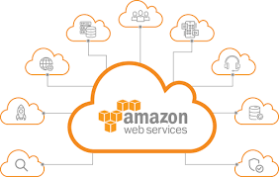
introduction
Terraform:
Infrastructure as Code (IaC) simplifies cloud resource management by enabling declarative configurations. Terraform, a powerful IaC tool, allows seamless provisioning and management of AWS resources, including Identity and Access Management (IAM).
Benefits of Using Terraform for IAM:
Automation: Reduces manual effort with reusable, declarative configurations.
Consistency: Ensures identical configurations across environments.
Scalability: Easily accommodates growing access management needs.
Auditability: Maintains a clear history of changes through version control.

Slide 4
Code Description and Explanation
This Terraform code is designed to provision resources in AWS using the ap-south-1 (Mumbai) region. It includes IAM (Identity and Access Management) configurations, an EC2 instance setup, and security configurations. Below is an explanation of the code components:
1. AWS Provider Configuration
provider "aws" {
region = "ap-south-1"
}
# Default VPC
data "aws_vpc" "default" {
default = true
}
# Get default subnets
data "aws_subnet" "default_subnets" {
vpc_id = data.aws_vpc.default.id
availability_zone = "ap-south-1a"
}
Configures the AWS provider for the ap-south-1 region (Mumbai).
2. Default VPC and Subnet Data
Fetches details of the default VPC and a subnet in availability zone ap-south-1a.
Ensures the EC2 instance is created in the default VPC and subnet.

Slide 5
3. IAM Group and Policies
# IAM Group and Policies
resource "aws_iam_group" "group_prem" {
name = "group_prem"
}
resource "aws_iam_policy" "ec2_full_access" {
name = "EC2FullAccess"
description = "EC2 Full Access"
policy = jsonencode({
Version = "2012-10-17"
Statement = [
{
Effect = "Allow"
Action = "ec2:*"
Resource = "*"
}
]
})
}
resource "aws_iam_policy" "s3_list_buckets" {
name = "S3ListAllMyBuckets"
description = "S3 List All My Buckets"
policy = jsonencode({
Version = "2012-10-17"
Statement = [
{
Effect = "Allow"
Action = "s3:ListAllMyBuckets"
Resource = "*"
}
]
})
}
resource "aws_iam_policy" "cloudwatch_read_access" {
name = "CloudWatchReadAccess"
description = "CloudWatch Read Access"
policy = jsonencode({
Version = "2012-10-17"
Statement = [
{
Effect = "Allow"
Action = "cloudwatch:*"
Resource = "*"
}
]
})
}
IAM Group
Creates an IAM group named group_prem.
IAM Policies
EC2 Full Access: Allows all actions on EC2 resources.
S3 List Buckets: Allows listing all S3 buckets.
CloudWatch Read Access: Grants read-only access to CloudWatch.
IAM Group Policy Attachments
Attache the policies to the group_prem IAM group.
# IAM Group Attachments
resource "aws_iam_group_policy_attachment" "group_prem_ec2_full_access" {
group = aws_iam_group.group_prem.name
policy_arn = aws_iam_policy.ec2_full_access.arn
}
resource "aws_iam_group_policy_attachment" "group_prem_s3_list" {
group = aws_iam_group.group_prem.name
policy_arn = aws_iam_policy.s3_list_buckets.arn
}
resource "aws_iam_group_policy_attachment" "group_prem_cloudwatch_read" {
group = aws_iam_group.group_prem.name
policy_arn = aws_iam_policy.cloudwatch_read_access.arn
}

Slide 6
4. IAM Role and Instance Profile
IAM Role
Creates a role named role_prem with a trust relationship for EC2 instances (ec2.amazonaws.com).
# IAM Role
resource "aws_iam_role" "role_prem" {
name = "role_prem"
assume_role_policy = jsonencode({
Version = "2012-10-17"
Statement = [
{
Effect = "Allow"
Action = "sts:AssumeRole"
Principal = {
Service = "ec2.amazonaws.com"
}
}
]
})
}
# IAM Instance Profile
resource "aws_iam_instance_profile" "my_iam_profile" {
name = "my_iam_profile"
role = aws_iam_role.role_prem.id
}
Instance Profile
Creates an instance profile named my_iam_profile linked to the IAM role role_prem.
Allows EC2 instances to assume the role for accessing AWS resources.

Slide 7
5. IAM User Configuration
IAM User
Creates an IAM user named prem.
User Login Profile
Configures a login profile for the user,
enforcing password reset at first login.
User Group Membership
Adds the user prem to the IAM group group_prem.
# IAM User
resource "aws_iam_user" "user_prem" {
name = "prem"
}
resource "aws_iam_user_login_profile" "user_prem_profile" {
user = aws_iam_user.user_prem.name
password_reset_required = true
}
resource "aws_iam_user_group_membership" "user_prem_group_membership" {
user = aws_iam_user.user_prem.name
groups = [aws_iam_group.group_prem.name]
}

Slide 8
# Security Group for EC2
resource "aws_security_group" "ec2_sg" {
vpc_id = data.aws_vpc.default.id
ingress {
from_port = 22
to_port = 22
protocol = "tcp"
cidr_blocks = ["0.0.0.0/0"]
}
ingress {
from_port = 8080
to_port = 8080
protocol = "tcp"
cidr_blocks = ["0.0.0.0/0"]
}
ingress {
from_port = 9000
to_port = 9000
protocol = "tcp"
cidr_blocks = ["0.0.0.0/0"]
}
egress {
from_port = 0
to_port = 0
protocol = "-1"
cidr_blocks = ["0.0.0.0/0"]
}
tags = {
Name = "EC2SG"
}
}
6. Security Group
Configures inbound and outbound traffic rules for the EC2 instance to ensure secure connectivity.
Ingress Rules:
Port 22 (SSH): Allows remote server access.
Port 8080 (HTTP): Enables access to hosted web applications.
Port 9000 (SonarQube): Grants access to the SonarQube dashboard.
Egress Rules:
Allows unrestricted outbound traffic for internet communication.

Slide 9
7. EC2 Instance Configuration
# EC2 Instance
resource "aws_instance" "ec2_instance" {
ami = "ami-053b12d3152c0cc71"
instance_type = "t2.medium"
key_name = "new-key"
vpc_security_group_ids = [aws_security_group.ec2_sg.id]
iam_instance_profile = aws_iam_instance_profile.my_iam_profile.name
subnet_id = data.aws_subnet.default_subnets.id
tags = {
Name = "EC2Instance"
}
}
Provisions an Ubuntu 20.04 EC2 instance for deploying applications.
AMI: Ubuntu 20.04 (ami-053b12d3152c0cc71).
Instance Type: t2.medium for moderate performance.
Key Pair: new-key enables secure SSH access.
Subnet: Launches in the default subnet of ap-south-1a.
Security Group: Uses ec2_sg to manage inbound and
outbound traffic.
IAM Instance Profile: Assigns my_iam_profile to
grant instance access to AWS services securely.

Slide 10
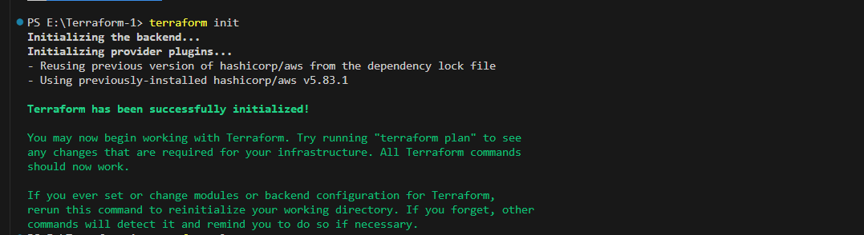
Steps to Initialize, Plan, and Apply Terraform
Initialize Terraform
Run terraform init to:
Download and configure the necessary provider plugins.
Prepare the working directory for Terraform usage.
Ensure the backend configuration (if defined) is initialized.
Validate Terraform Configuration (Optional)
Use terraform validate to check the syntax and integrity of the Terraform files.

Slide 11
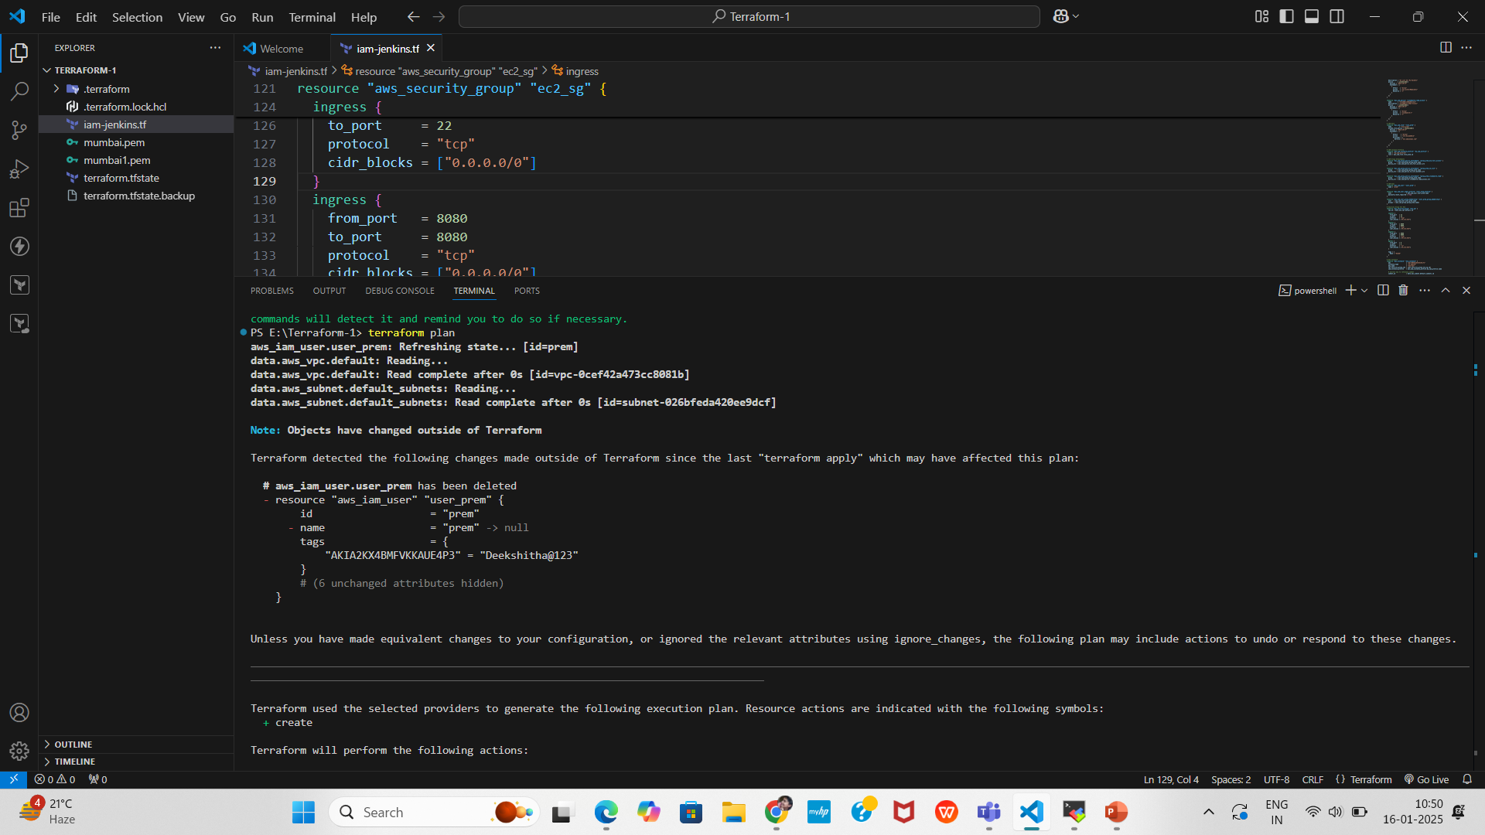
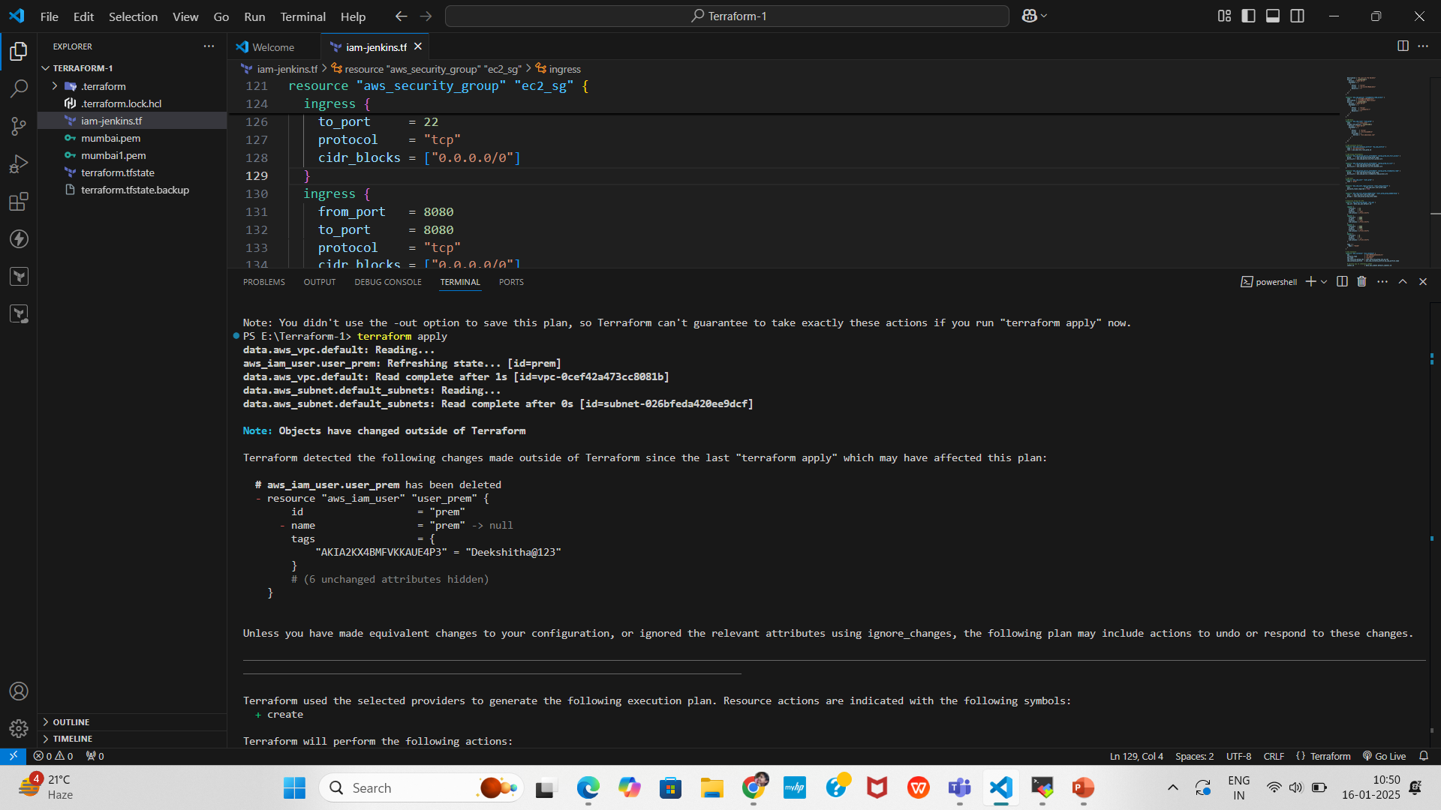
Plan Terraform Execution
Run terraform plan to:
Preview the changes Terraform will make to your infrastructure.
Ensure the configurations are correct before applying changes.
Apply Terraform Configuration
Execute terraform apply to:
Provision and configure resources as defined in your Terraform files.
Review and confirm the changes if prompted.

Slide 12
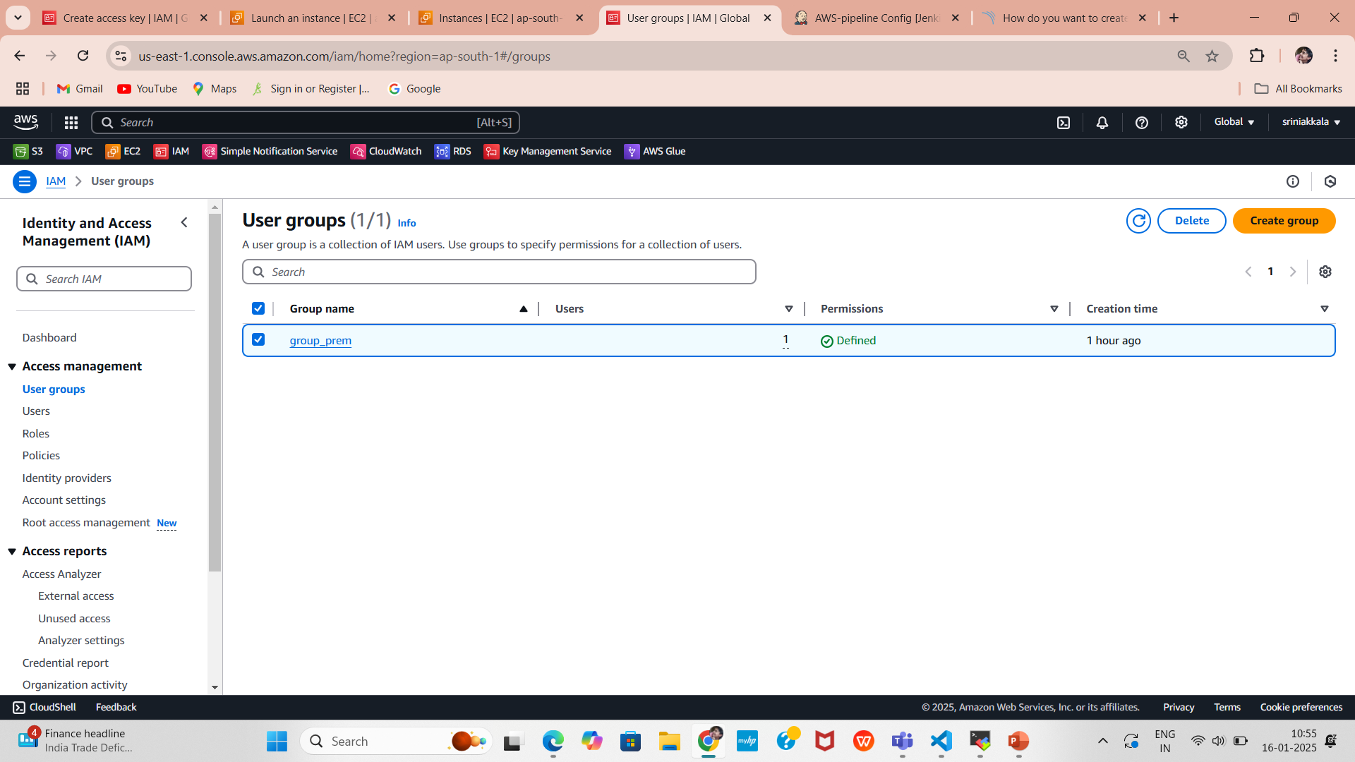
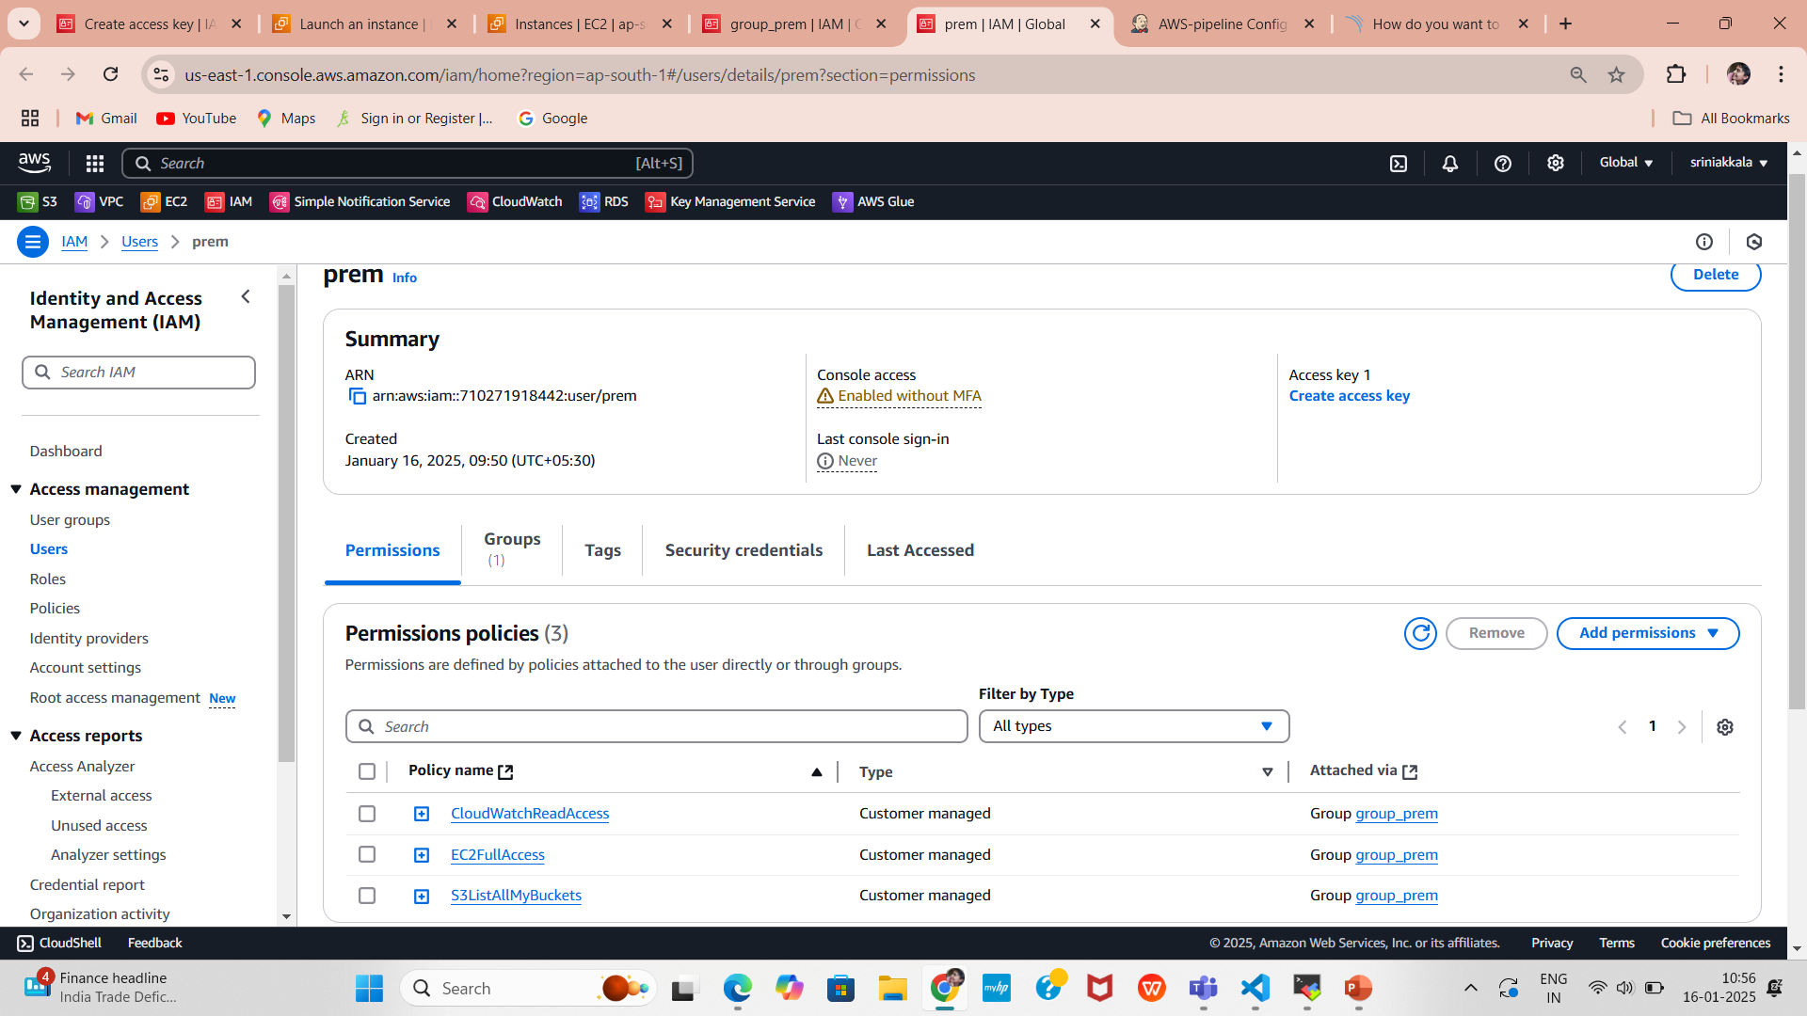
Verification Steps in AWS Management Console
Verify IAM Configurations
1.Navigate to the IAM Dashboard:
Log in to the AWS Console.
Go to Services > IAM.
2.Check IAM Group:
Verify the group group_prem is created under the Groups section.
Ensure the attached policies (EC2FullAccess, S3ListAllMyBuckets, and CloudWatchReadAccess) are correctly applied.

Slide 13
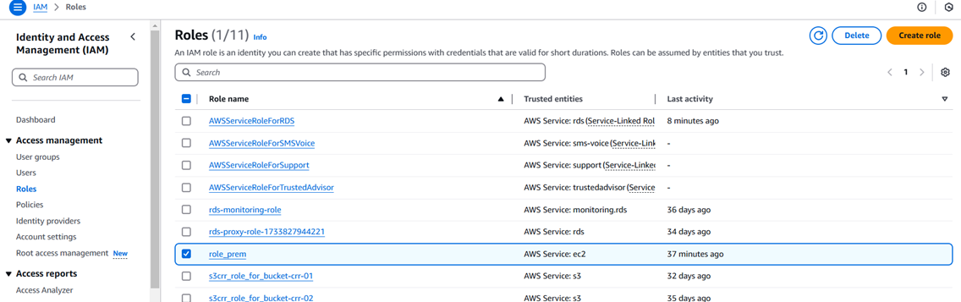
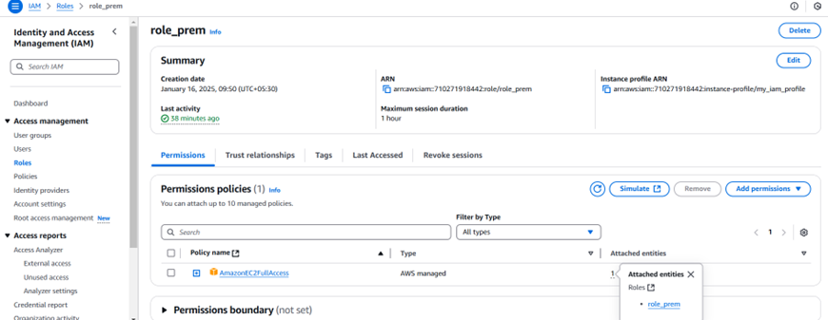
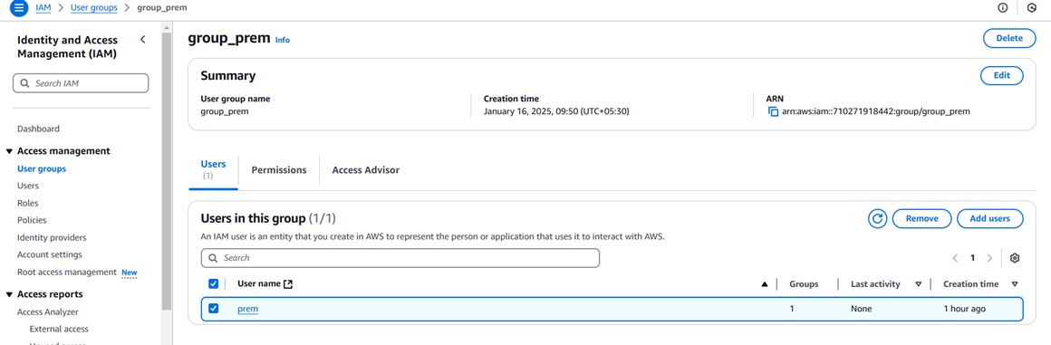
3.Check IAM Role:
Under the Roles section, confirm the role role_prem is created.
Check the Trust Relationships to ensure EC2 service is allowed to assume the role.
4.Check IAM User:
Go to the Users section.
Confirm the user prem is created and added to the group_prem.
Verify the login profile is configured (password reset required).

Slide 14
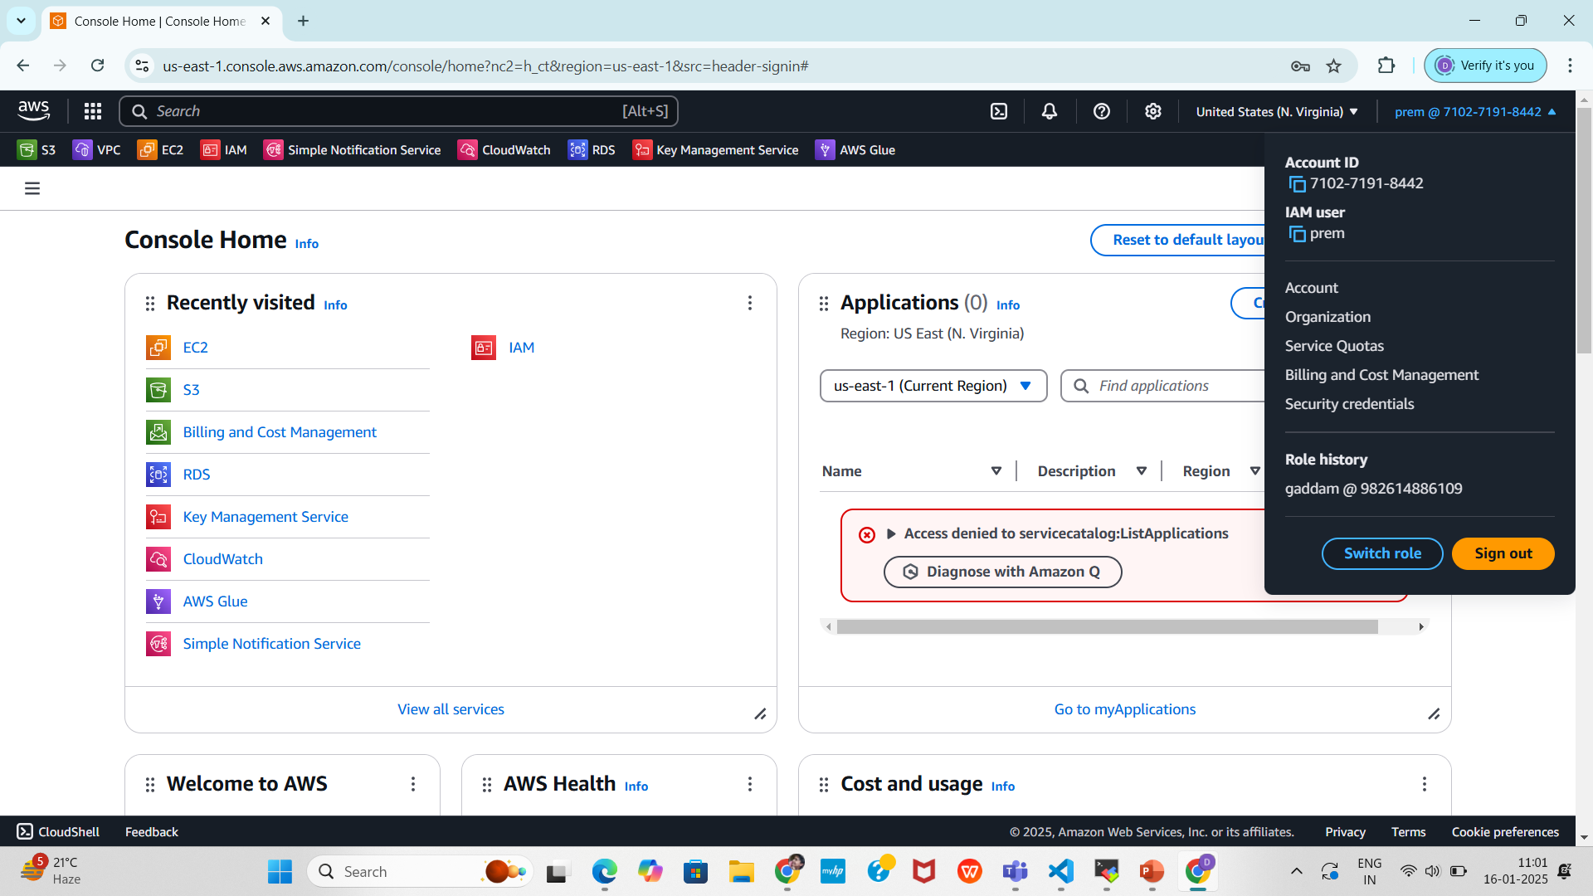
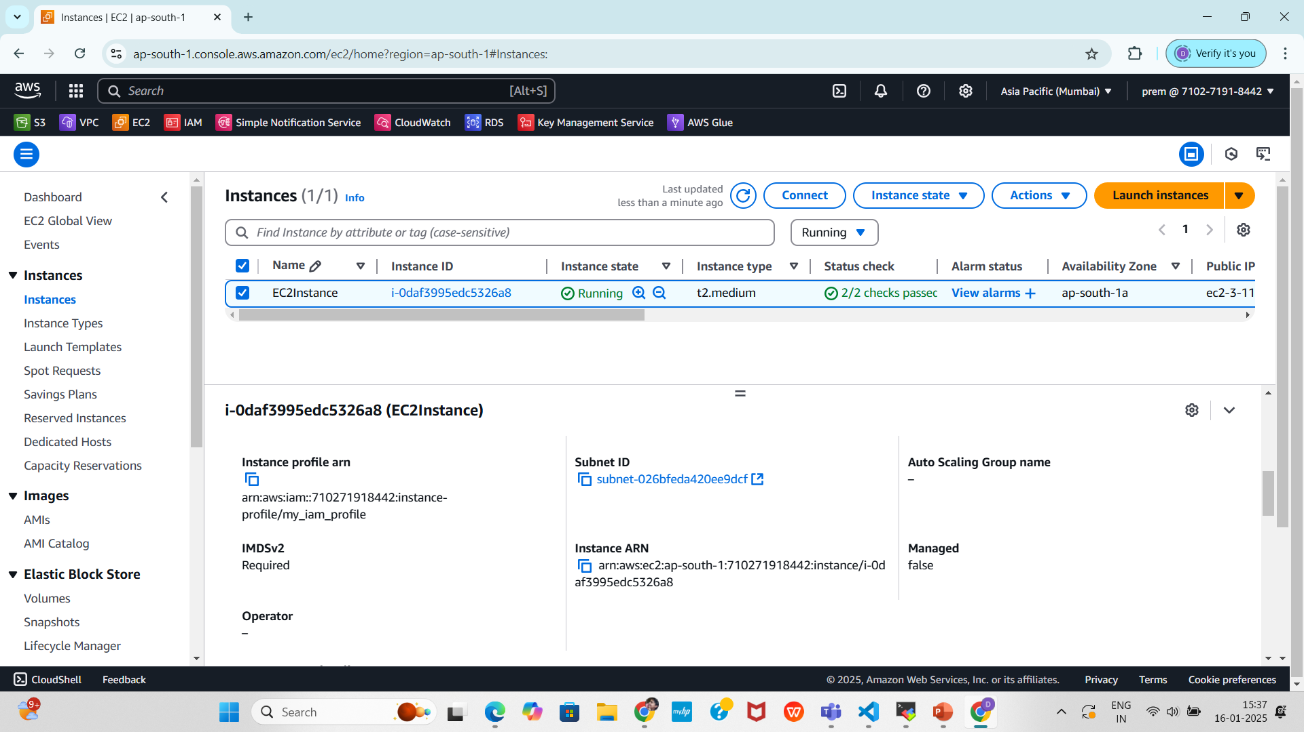
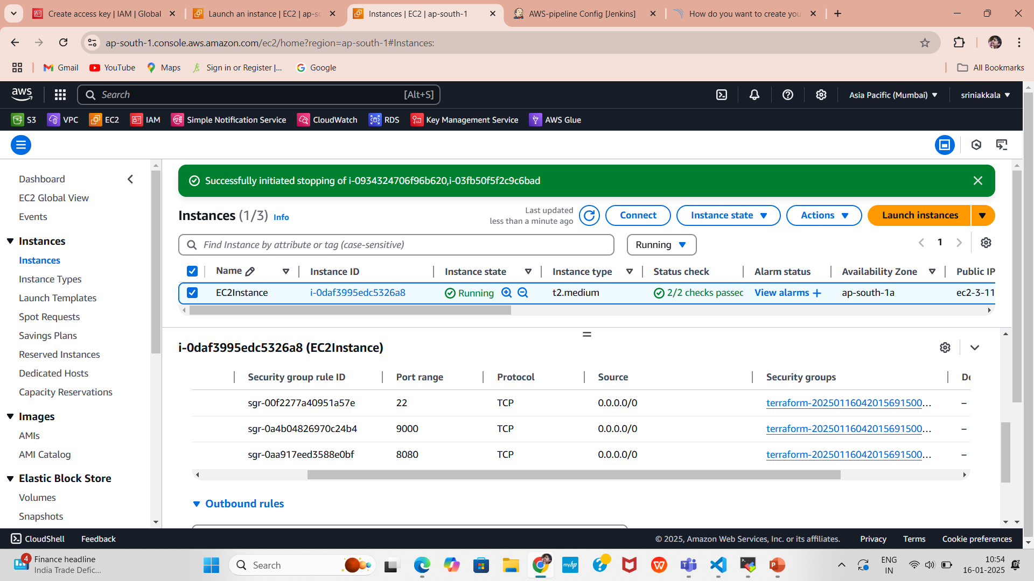
2. Verify EC2 Instance
2.1.Login to the User EC2 Dashboard:.
Go to Services > EC2.
2.2.Check Instances:
Verify the EC2 instance is running under the Instances
section.
Confirm the instance details:
AMI: Ubuntu 20.04 (ami-053b12d3152c0cc71).
Instance Type: t2.medium.
Subnet: Default subnet in ap-south-1a.
2.3.Check Security Group:
Go to the Security Groups section.
Verify the ec2_sg group is created with the following rules:
Inbound: Ports 22 (SSH), 8080 (HTTP), 9000 (SonarQube).
Outbound: All traffic allowed.

Slide 15

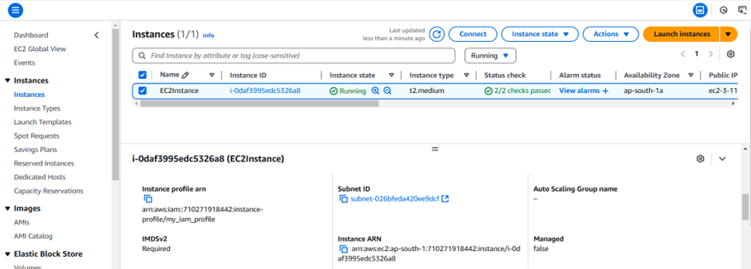
3.Verify IAM Instance Profile
3.1.Navigate to the IAM Dashboard:
Go to the Roles section.
Verify the role role_prem is associated with the instance
profile my_iam_profile.
3.2.Check the EC2 Instance in the EC2 Dashboard:
Confirm the instance has the IAM instance profile attached under
Description > IAM Role.

Slide 16
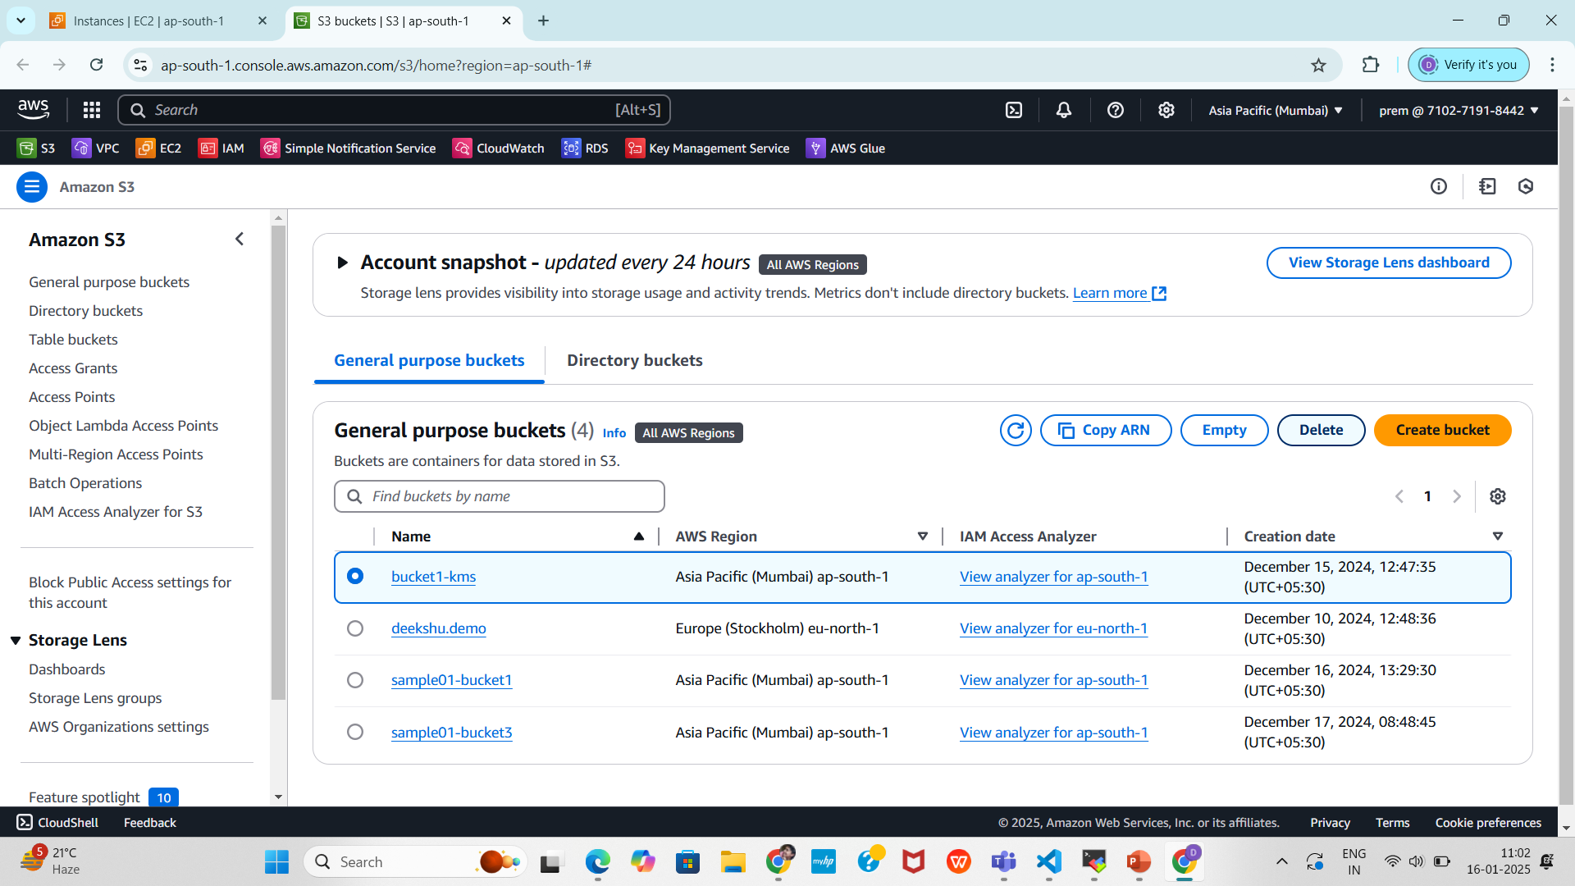
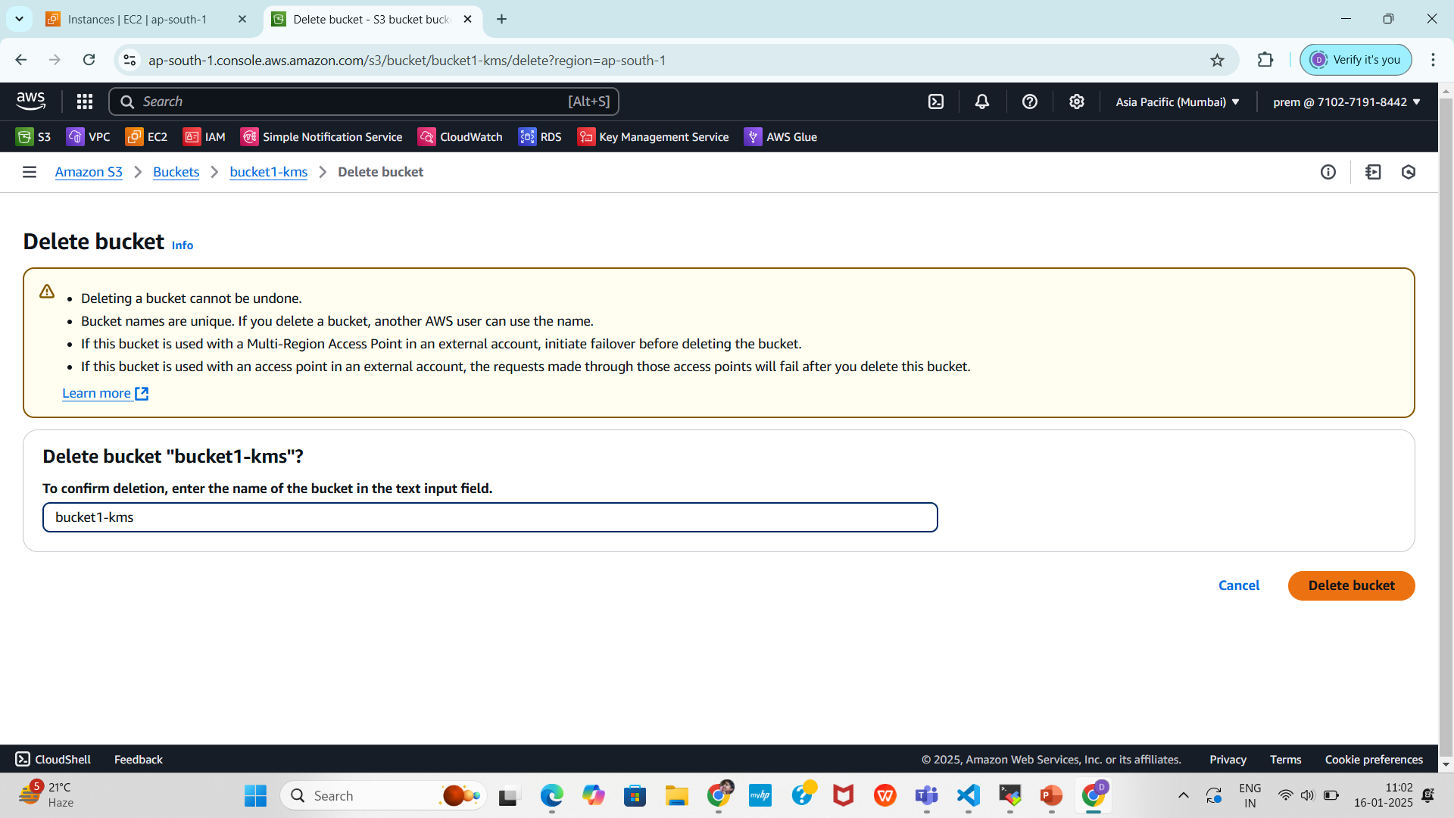
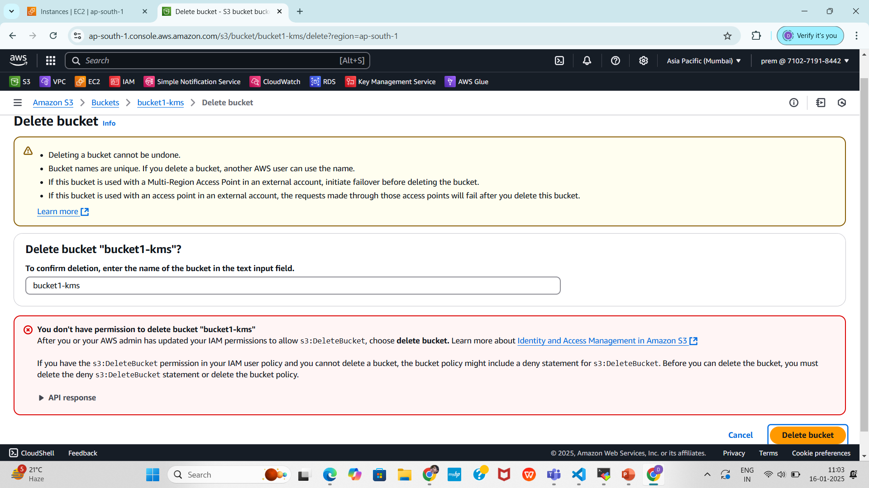
4.Verify S3 Access via AWS Console
4.1.Navigate to the S3 Dashboard:
Go to Services > S3.
Ensure that all available buckets are listed, confirming that the ListAllMyBuckets action is working for the prem user.
Select any bucket and attempt to delete it.
The IAM user prem should not have permissions to delete buckets.
Only for Listing the buckets the user have the permission

Slide 17
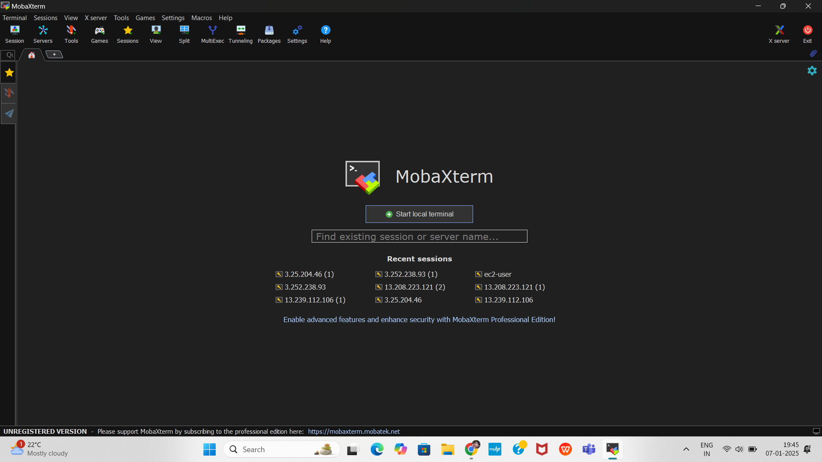
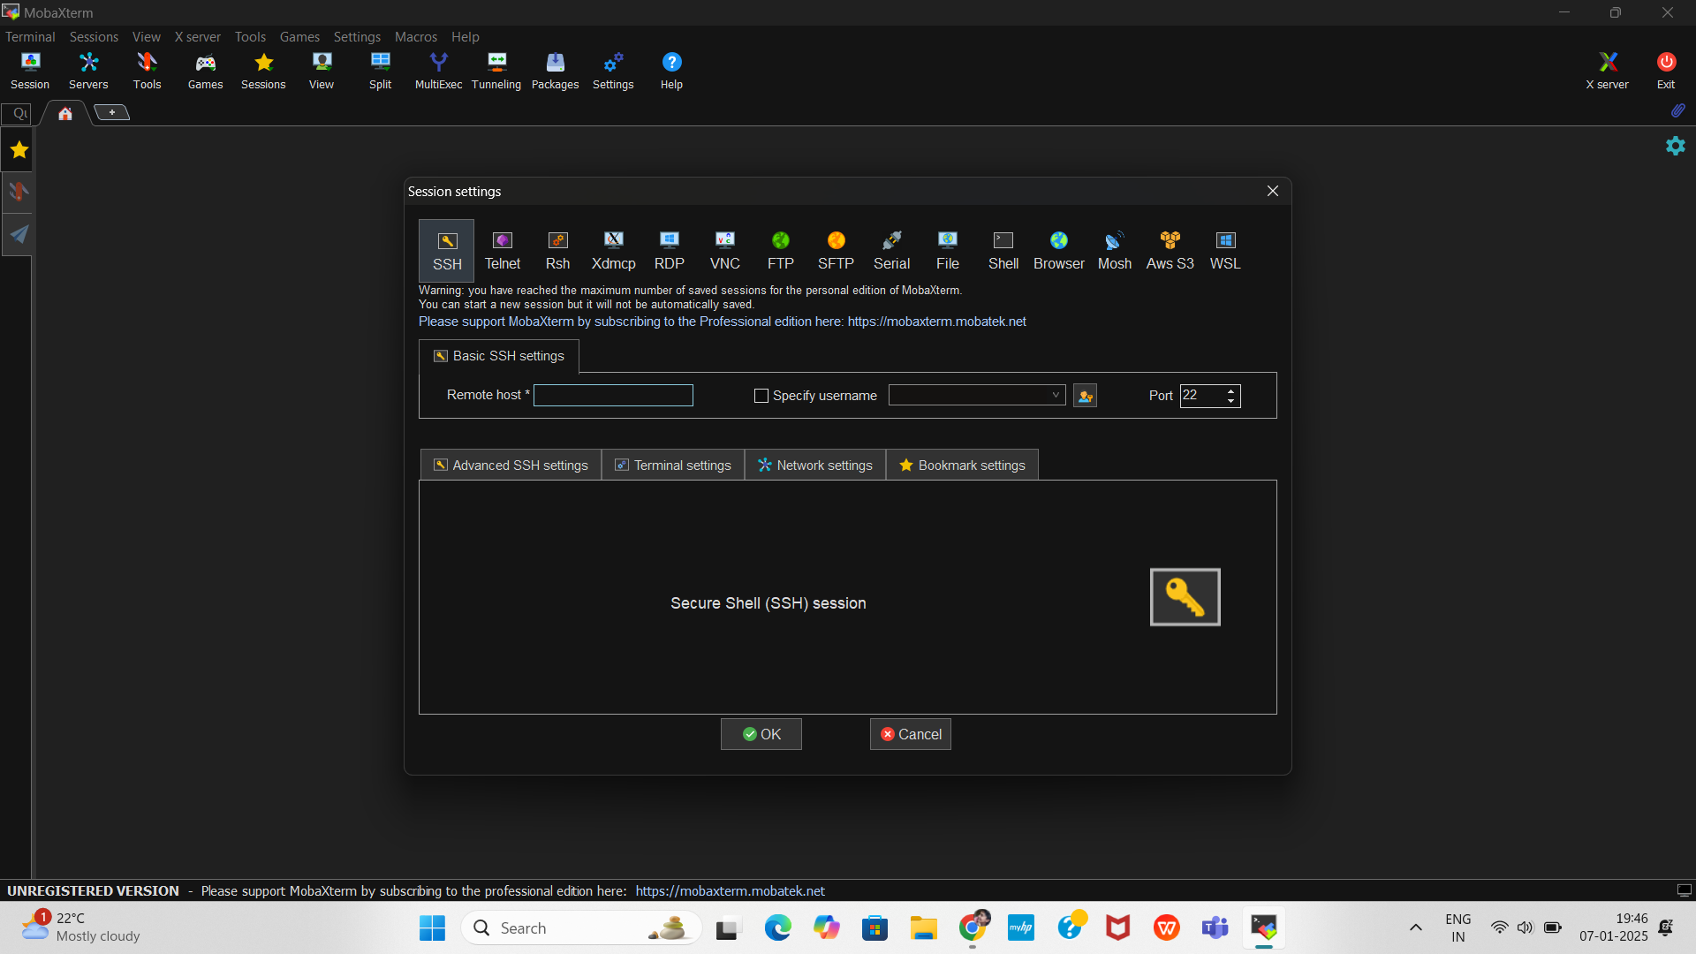
Connect to the EC2 Instance using MobaXterm
Here we can use MobaXterm, a popular SSH client, to connect to your AWS EC2 instance from your local system
Create a New SSH Session
In the MobaXterm home screen, click on Session in the top-left menu.
In the Session Settings, click SSH.
Enter the EC2 Instance Details
In the Remote Host field, enter your EC2 instance’s Public IP Address(3.110.178.160).
Ensure the Port is set to 22 (default SSH port).
Enter specify username (ubuntu) .

Slide 18
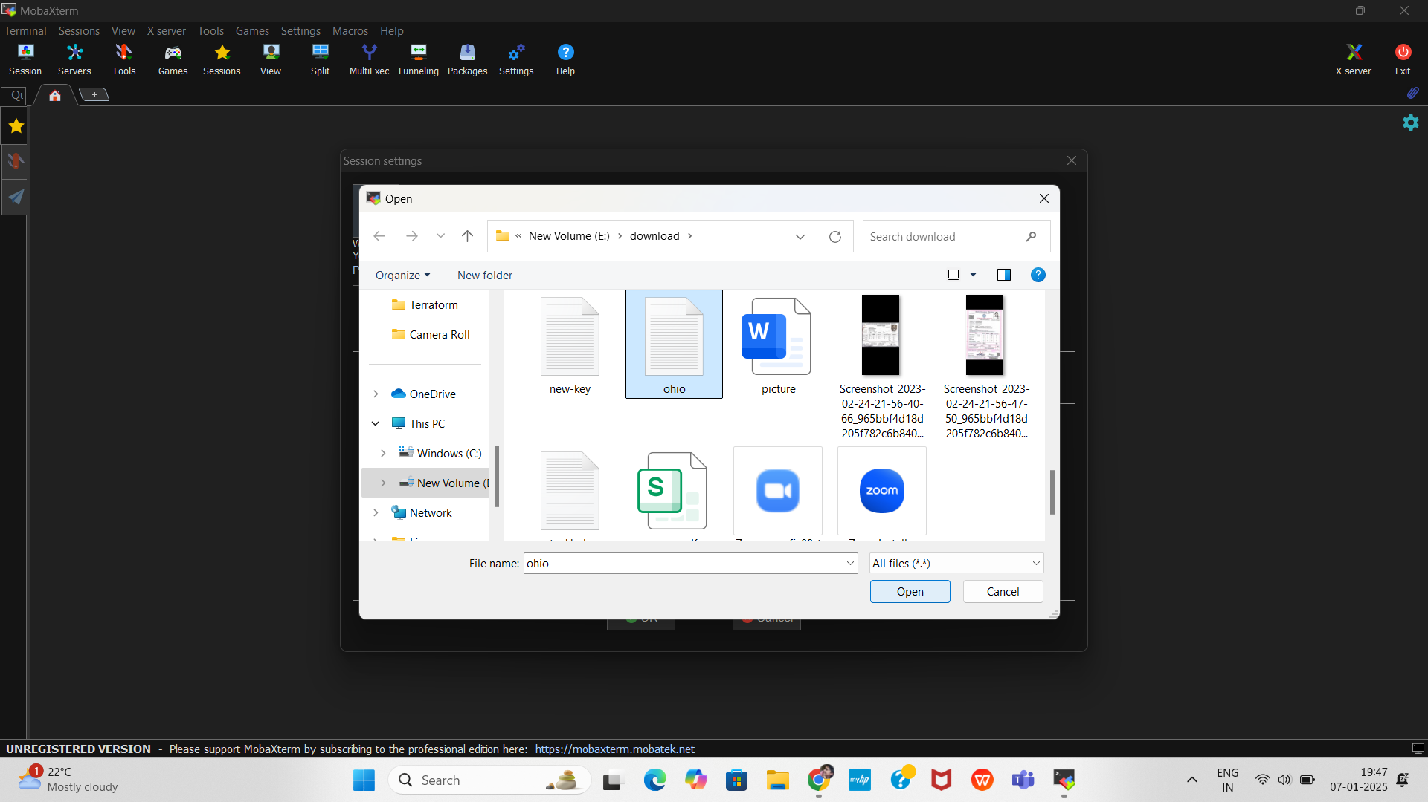
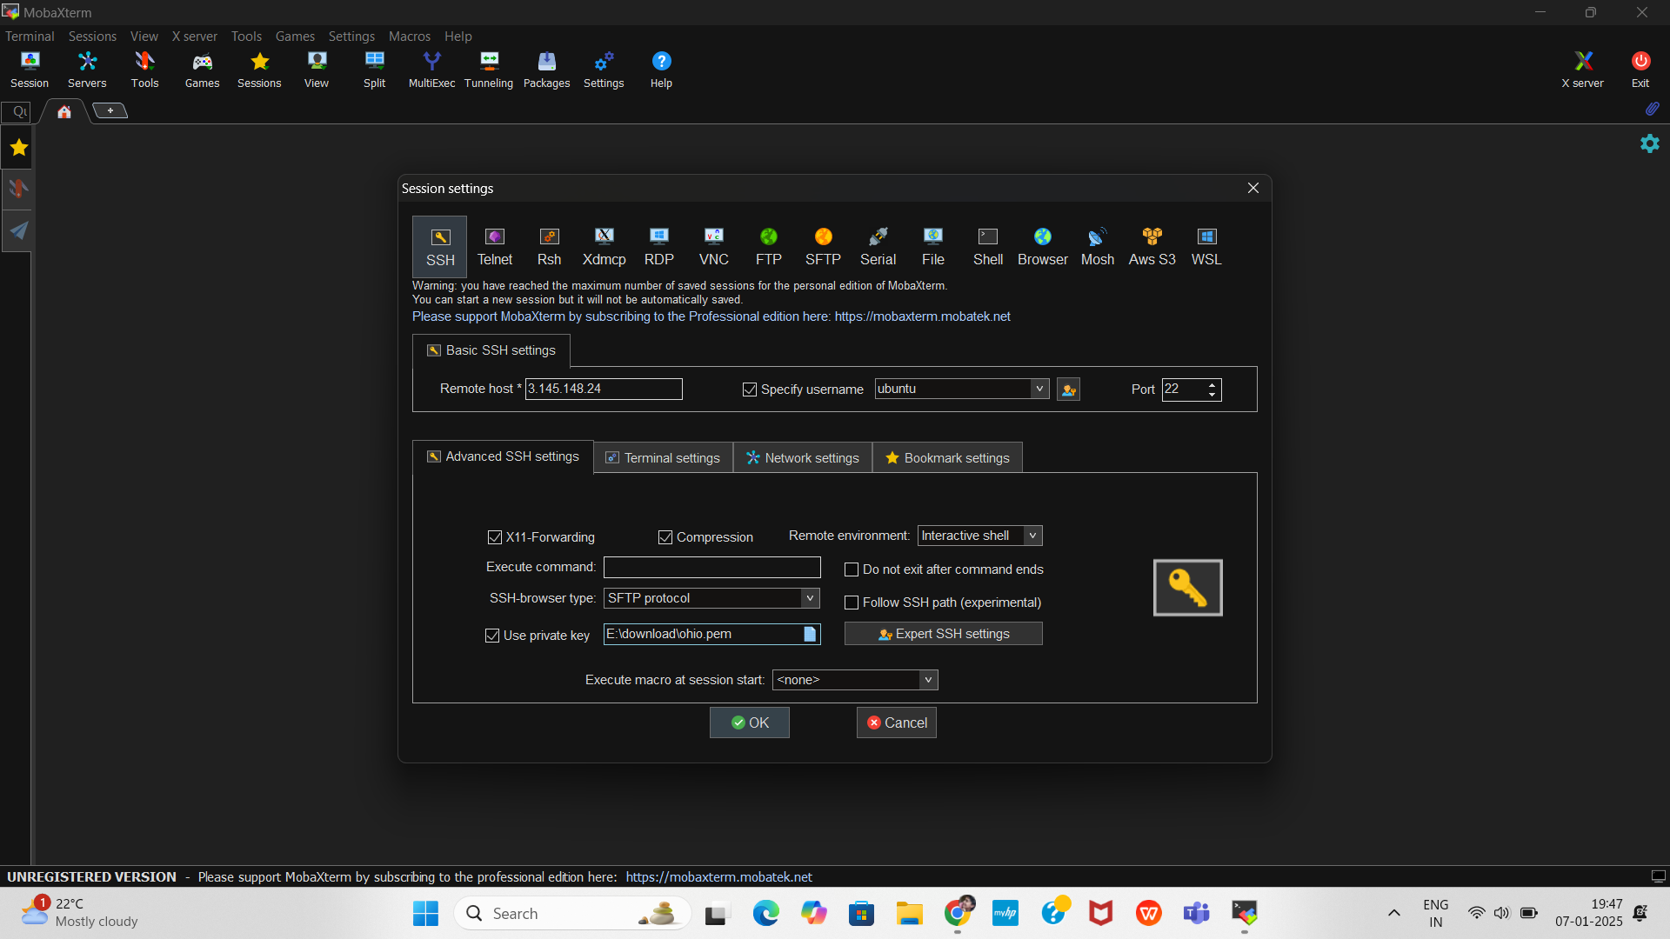
Configure the Private Key (PEM File)
In the SSH Session Settings, click on Advanced SSH Settings.
Under Use private key, click Browse and select your new-key.pem file (downloaded from AWS).
Click OK to save the settings.

Slide 19
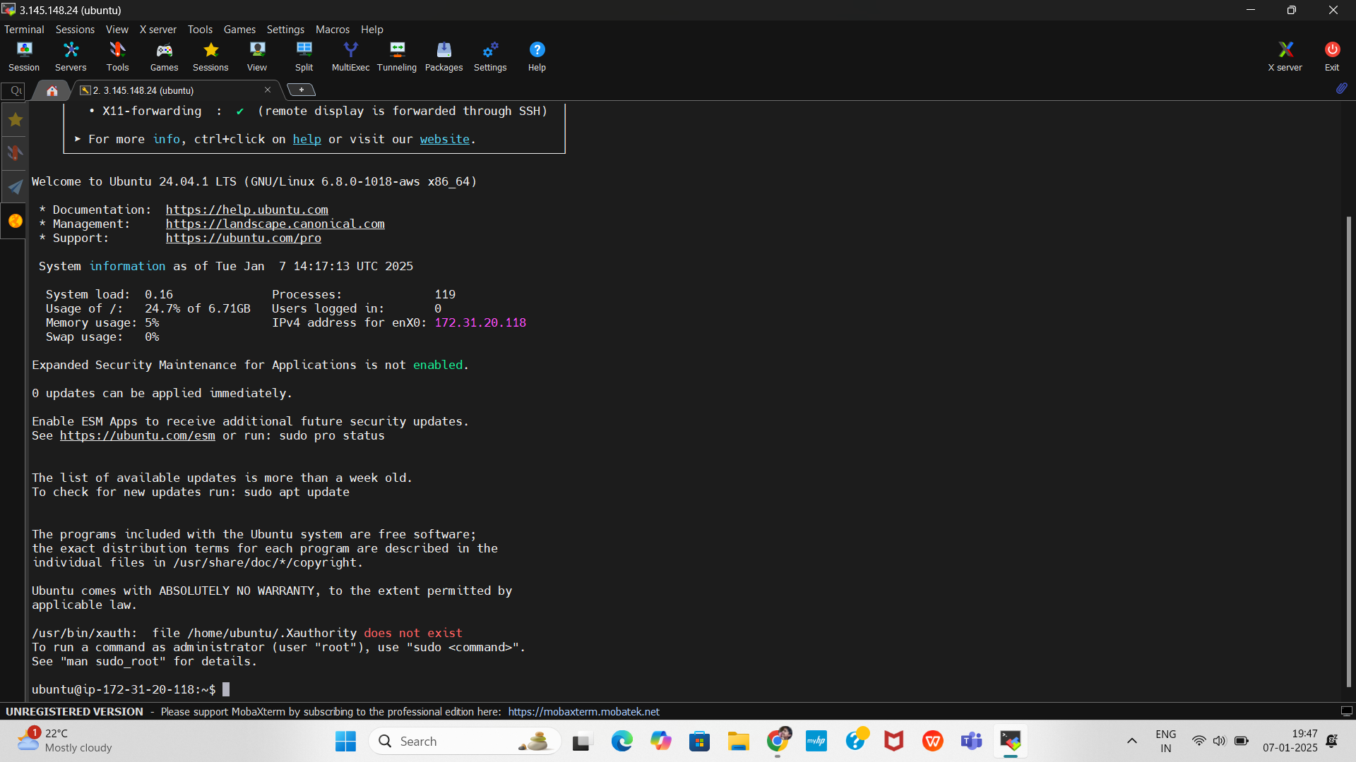
Login to the EC2 Instance
You are now connected to your EC2 instance via MobaXterm.

Slide 20

Introduction to Jenkins
Jenkins is a powerful, open-source automation server that helps streamline software development processes
by automating tasks related to building, testing, and deploying applications. It is widely used in DevOps to
enable Continuous Integration (CI) and Continuous Delivery (CD), ensuring faster, more reliable software releases.
Automates repetitive tasks like builds, tests, and deployments.
Reduces manual errors by ensuring consistency in build processes.
Detects code issues early with Continuous Integration.
Speeds up software delivery through Continuous Delivery pipelines.
Integrates with multiple tools such as Docker, SonarQube, Kubernetes, etc.
Continuous Integration: Automatically build and test code changes to detect errors early.
Continuous Delivery: Automate the deployment of applications to different environments.
Automated Testing: Run unit tests, integration tests, and performance tests.
Build Automation: Compile, package, and deliver artifacts using tools like
Maven, Gradle, and Ant.
Containerization and Deployment: Build Docker images and deploy them to
cloud environments or orchestration platforms.

Slide 21
Install Jenkins on the EC2 Instance
After connecting to your EC2 instance using MobaXterm follow the steps below to install Jenkins on Ubuntu.
Update the System Packages
Before installing any software, update the existing packages:
sudo apt update
sudo apt upgrade -y
Install Java
Jenkins requires Java to run. Install OpenJDK 17 with the following command
After the installation, verify the Java version.
Sudo apt update
Sudo apt install fontconfig openjdk-17-jre
Java -version

Slide 22
Add the Jenkins Repository
Add the Jenkins repository to your system’s source list.
sudo wget -O /usr/share/keyrings/jenkins-keyring.asc \
https://pkg.jenkins.io/debian-stable/jenkins.io-2023.key
echo deb [signed-by=/usr/share/keyrings/jenkins-keyring.asc] \
https://pkg.jenkins.io/debian-stable binary/ | sudo tee \
/etc/apt/sources.list.d/jenkins.list > /dev/null
Run the following commands to update the package list and install Jenkins.
sudo apt-get update
sudo apt-get install jenkins

Slide 23
Start and Enable Jenkins Service
1. Start the Jenkins Service
Explanation: This command starts the Jenkins service immediately. If Jenkins is installed correctly, this command will initialize and run Jenkins.
2. Enable Jenkins to Start Automatically on System Boot
Explanation: This command configures Jenkins to start automatically whenever the system reboots. It creates symbolic links to the Jenkins service configuration in system boot directories.
3. Verify the Jenkins Service Status
Explanation: This command checks whether the Jenkins service is running. It displays information such as:
The current status (active (running), inactive, or failed).
Start time and uptime.
Expected Output: If Jenkins is running successfully, you should see) Active (running) in the status output.
sudo systemctl start jenkins
Sudo systemctl enable jenkins
sudo systemctl status jenkins

Slide 24
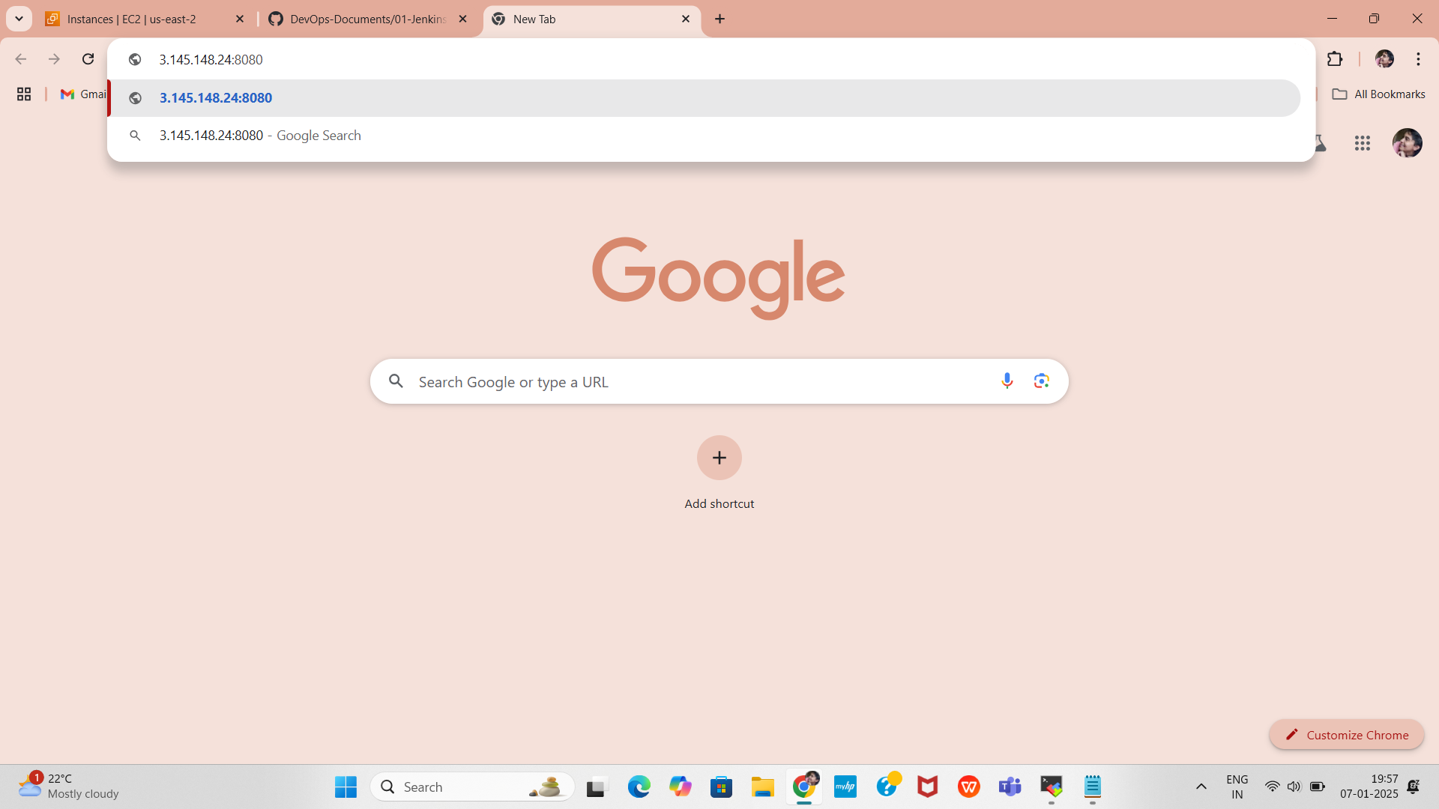
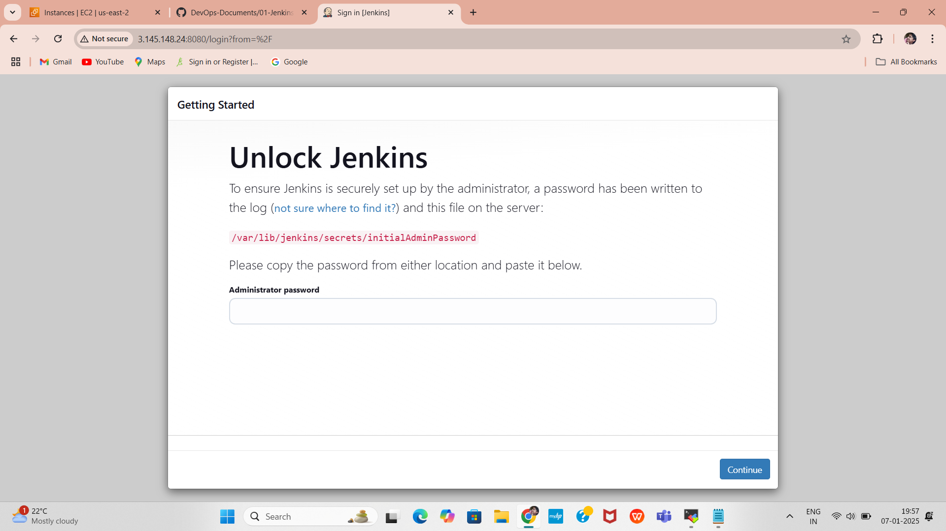
Open Web Chrome Port 8080
Jenkins runs on port 8080 by default. Ensure that port 8080 is open in your security group and allow it through the Ubuntu firewall.
Access Jenkins Web Interface
Open your browser and go to http://3.110.178.160:8080
You will see the Jenkins Unlock Screen.

Slide 25
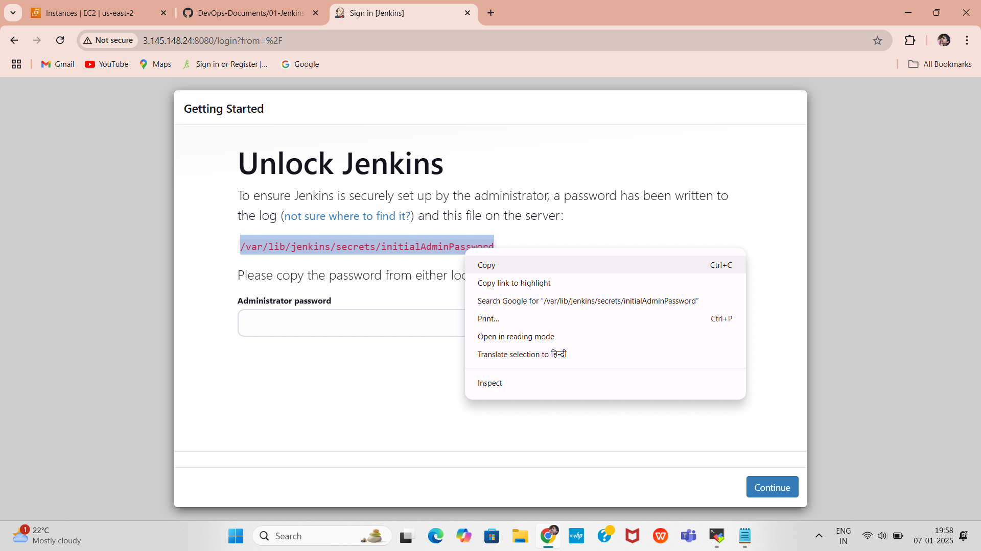
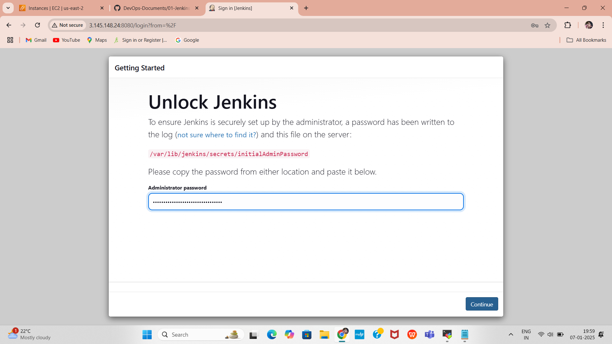
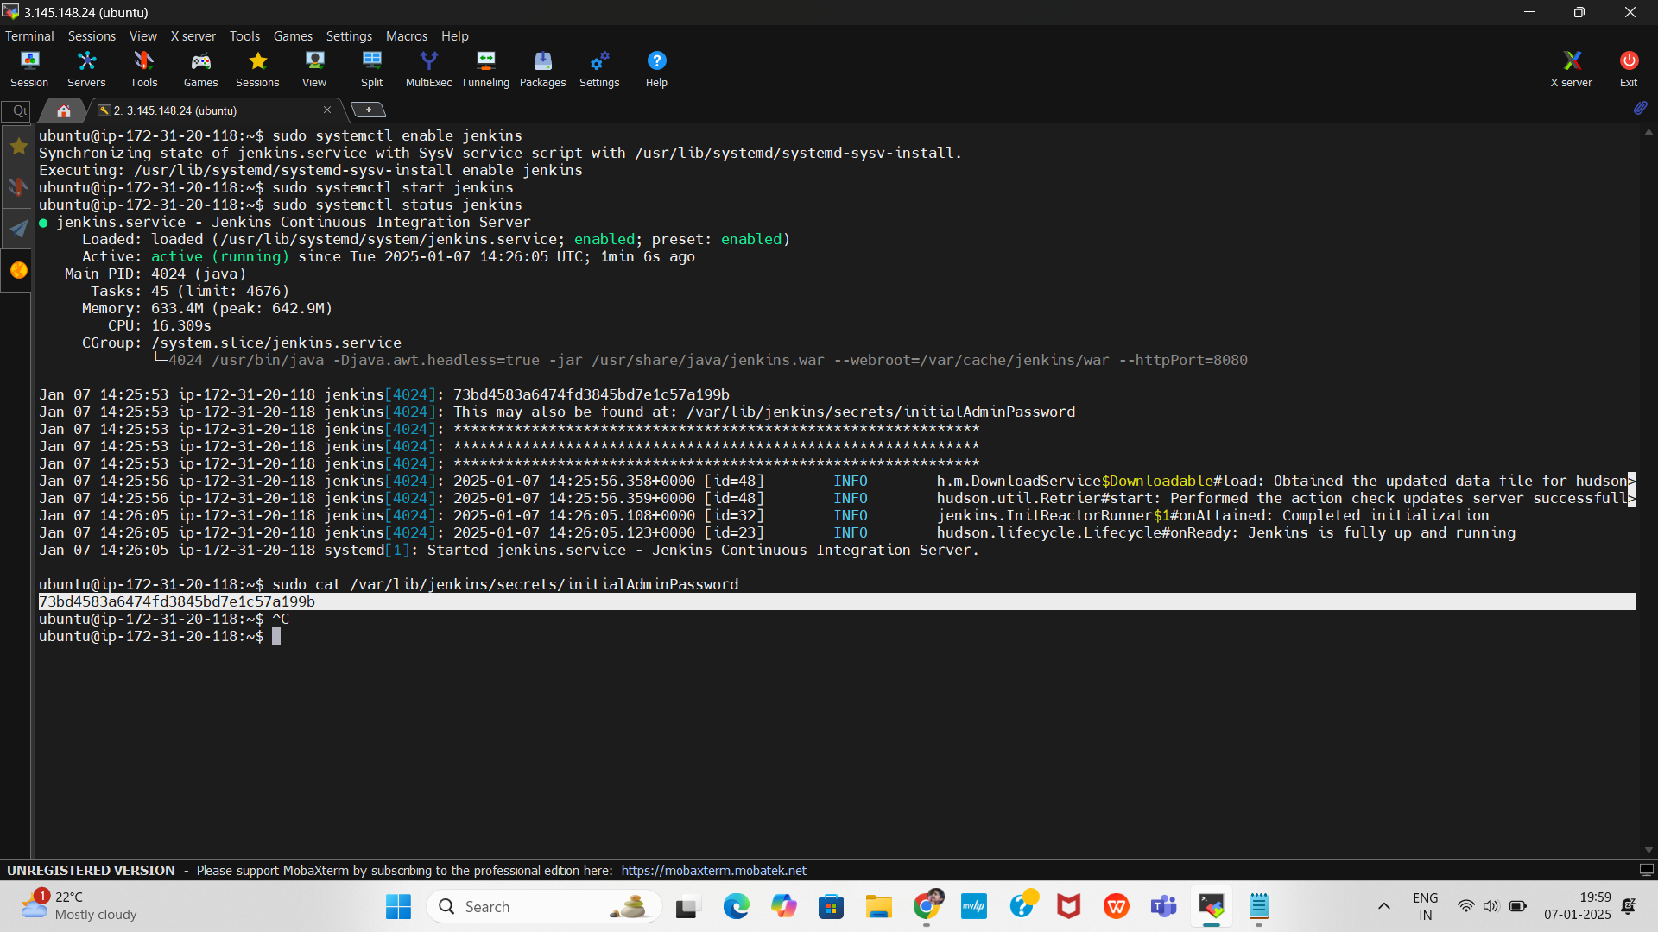
Unlock Jenkins
Run the following command on your EC2 instance to get the initial admin password:
Copy the password and paste it into the Jenkins web interface to unlock Jenkins.
sudo cat /var/lib/jenkins/secrets/initialAdminPassword

Slide 26
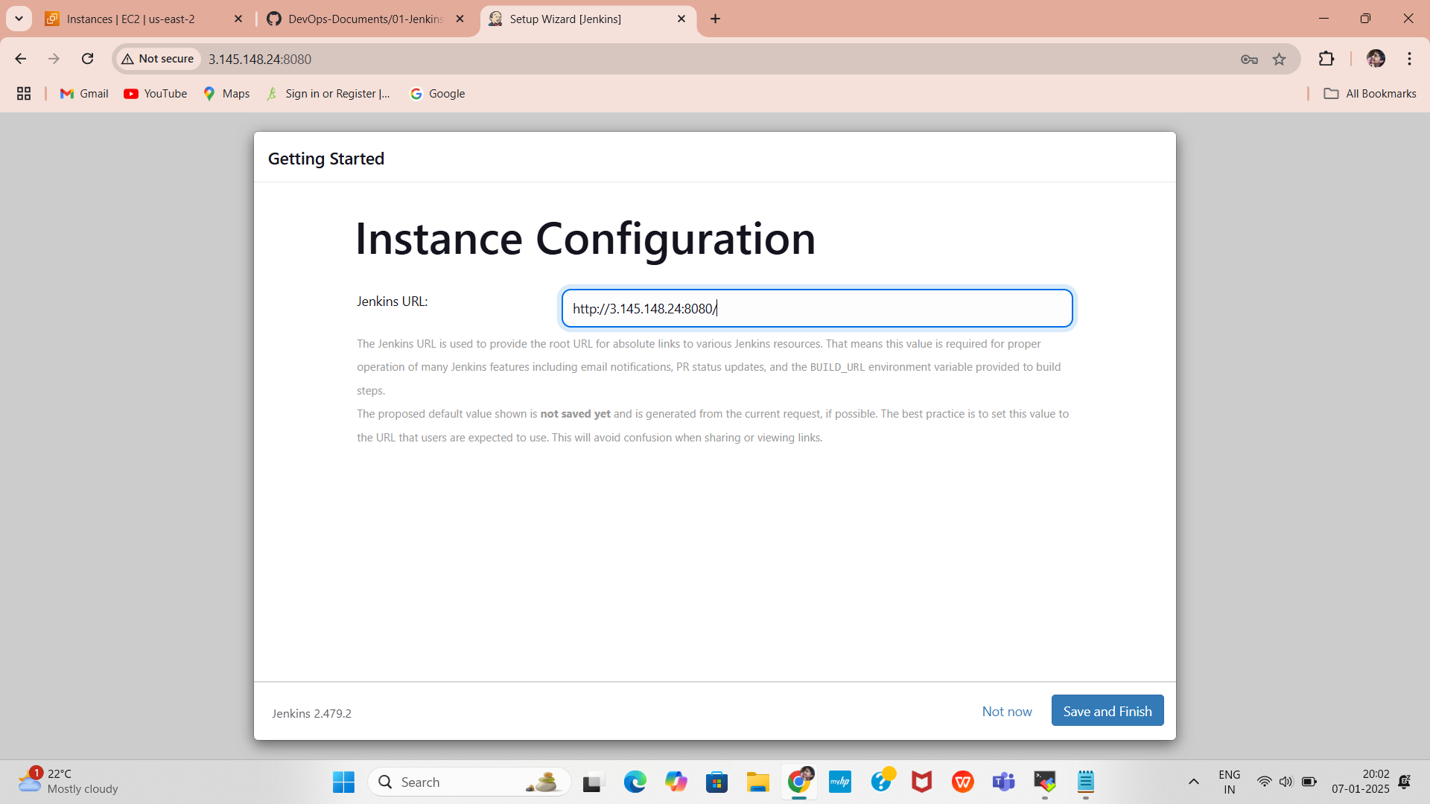
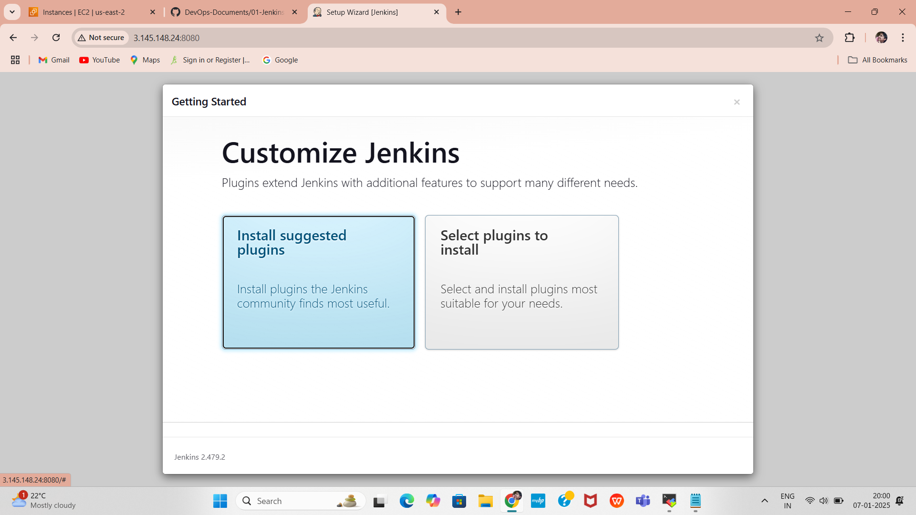
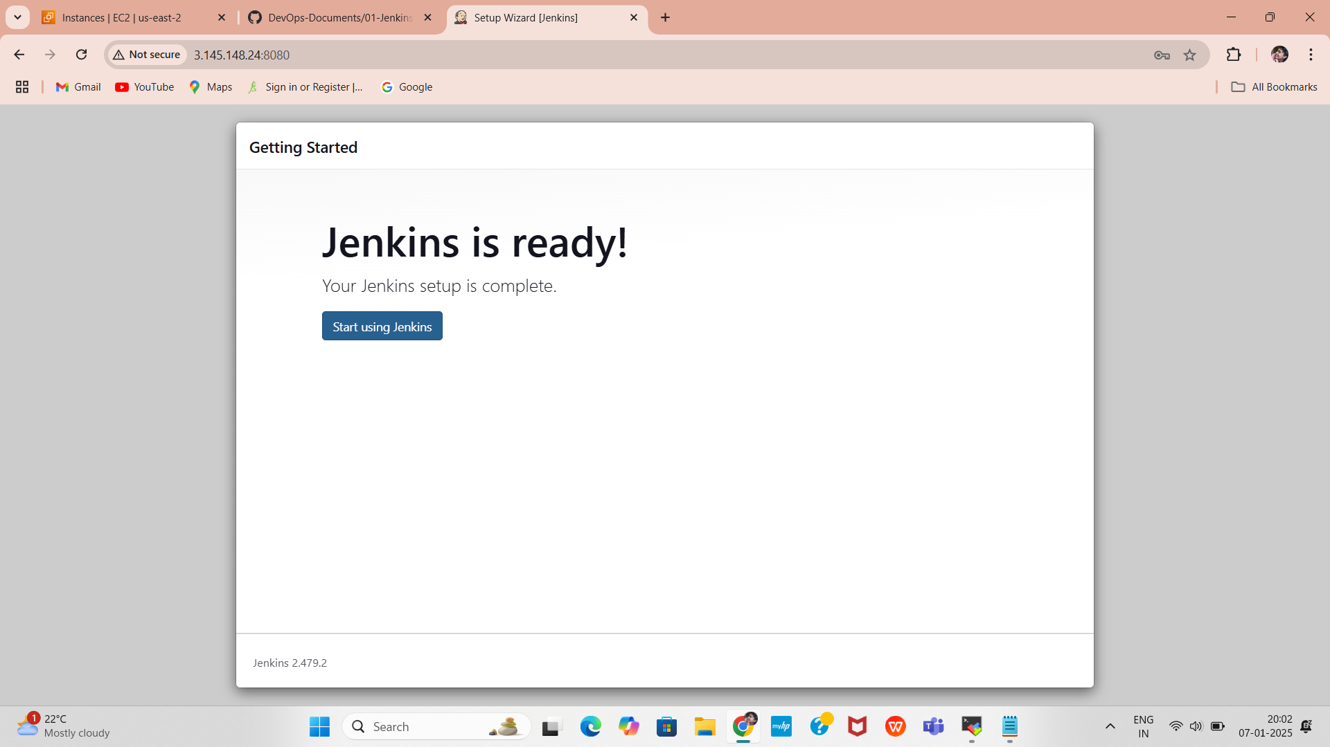
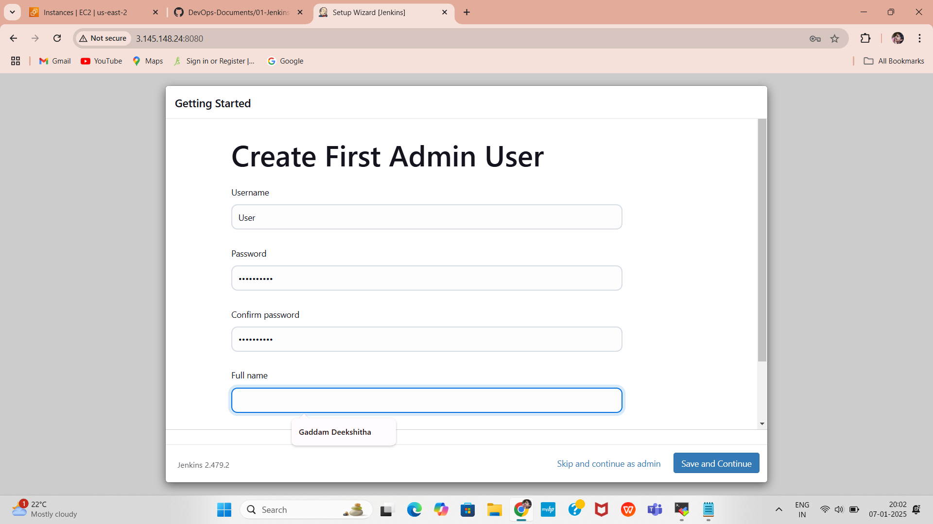
Complete Jenkins Setup
Install suggested plugins during the setup process.
Create an admin user account.
Complete the setup and start using Jenkins.

Slide 27
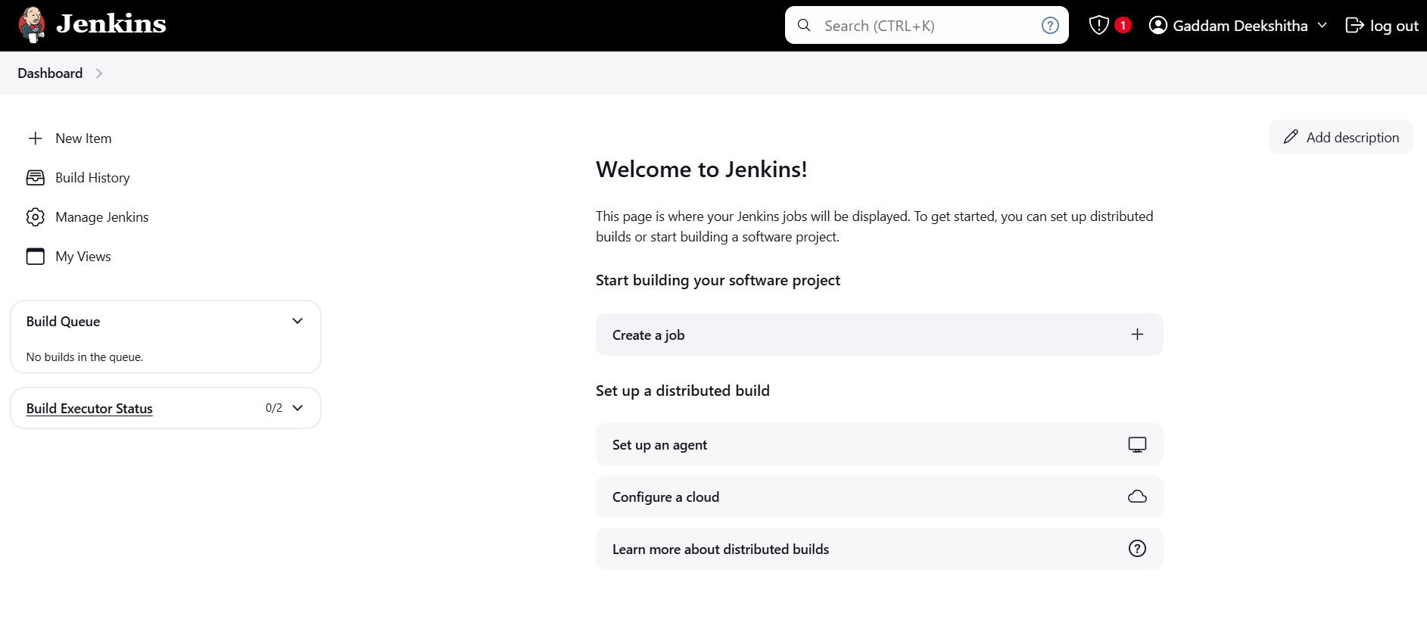
Jenkins Dashboard
After click on save and continue Jenkins dashboard page will open
After created Jenkins Dashboard again got the Instance and install the docker

Slide 28
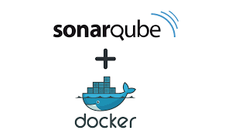
Introduction to Docker and SonarQube
Docker is a popular containerization platform that allows developers to package applications and their dependencies into a lightweight, portable container. These containers can run consistently across different environments, such as development, testing, and production.
With Docker, you can easily create a SonarQube instance by using a Docker image, eliminating the need for manual installation and configuration.
Using Docker to set up SonarQube simplifies the process by allowing you to:
Run SonarQube in a portable container without affecting your host system.
Easily manage dependencies and configurations.
Scale and manage the SonarQube instance more efficiently.
Quickly deploy SonarQube on any machine that supports Docker.

Slide 29

SonarQube is an open-source platform used to ensure code quality and code security by continuously analyzing source code. It helps developers identify issues, vulnerabilities, and bugs early in the development lifecycle, making it easier to maintain clean, secure, and maintainable code.
Improves Code Quality: Ensures clean, maintainable, and efficient code.
Enhances Security: Detects security vulnerabilities early in the development process.
Automates Code Reviews: Reduces manual effort by automating code analysis and providing actionable insights.
Integrates with Development Tools: Works with popular tools and platforms to fit seamlessly into existing workflows.
Supports DevOps Practices: Ensures that code quality checks are part of the DevOps pipeline.

Slide 30
Installing Docker and Running SonarQube in a Docker Container
Need to install Docker on an Ubuntu-based EC2 instance and run SonarQube using a Docker container.
First, update the existing packages on your EC2 instance and Install Docker
After Installing the docker create user in usermod by using sudo usermod -aG docker $USER #my case is ubuntu
Then New group for docker by using newgrp docker
sudo apt update
curl -fsSL get.docker.com | /bin/bash
sudo usermod -aG docker ubuntu
exit
Check if Docker is successfully installed by running
You should see the Docker version displayed in the terminal.
docker -v

Slide 31
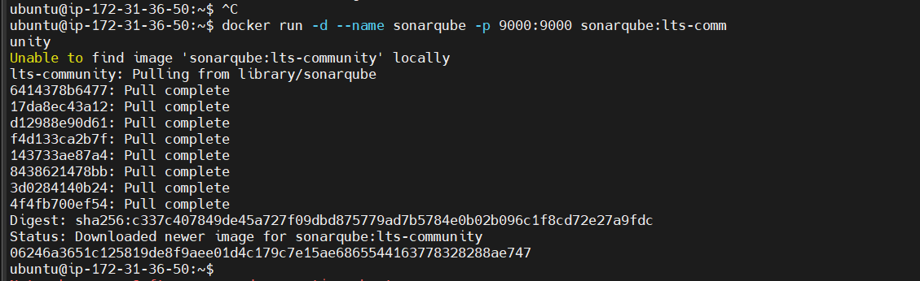
After the docker installation, we create a sonarqube container by using :
Then connect the SonarQube by using Instance public IPV4address:9000 (3.110.178.160:9000) (SonarQube default port number)
docker run -d --name sonar -p 9000:9000 sonarqube:lts-community

Slide 32
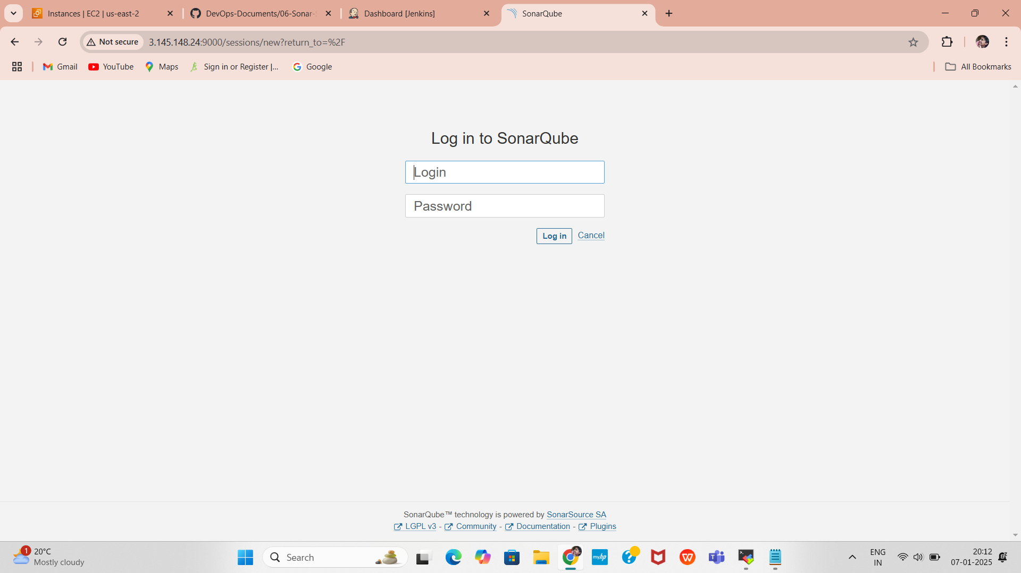
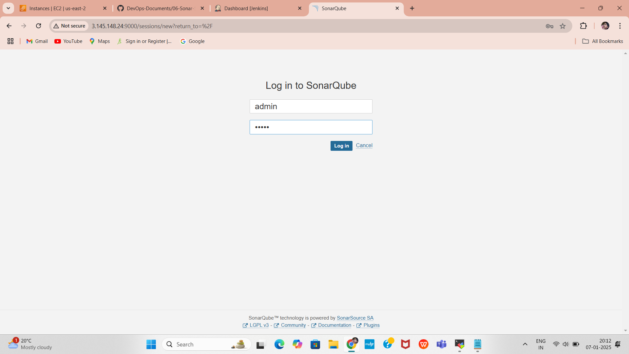
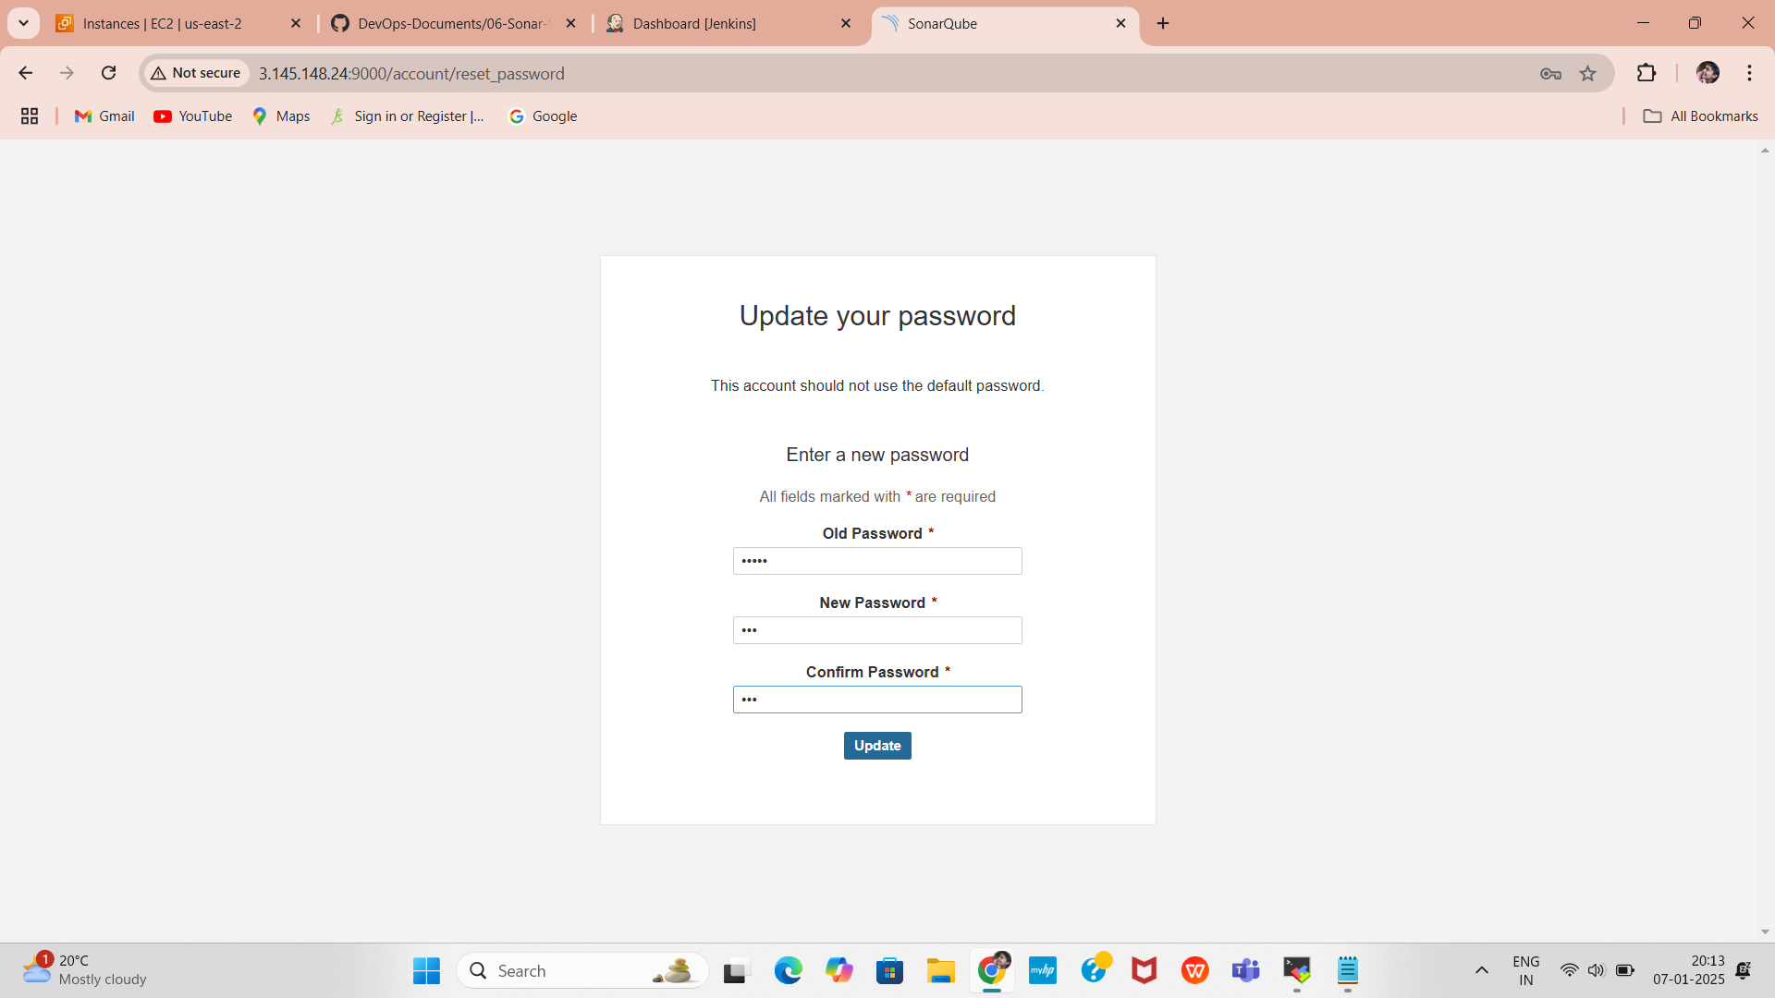
Open Web Chrome Port 9000
SonarQube runs on port 9000 . Ensure that port 9000 is open in your security group and allow it through the Ubuntu firewall.
Access sonarqube Web Interface, Open your browser and go to http://3.110.178.160:9000
Use the default credentials to log in (if not modified):
Username: admin
Password: admin
Change Default Password:
After the first login, you will be prompted to change the password.

Slide 33
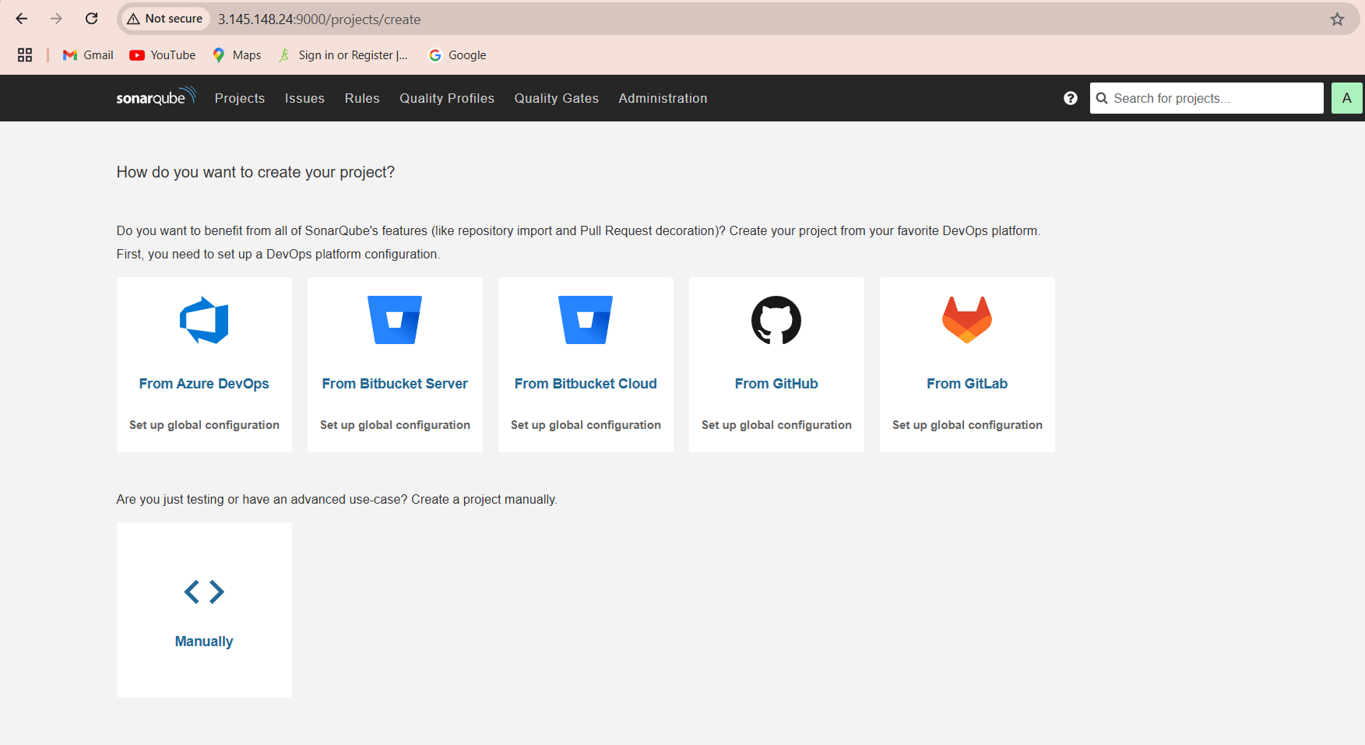
SonarQube Dashboard
After click on Login and continue Sonarqube dashboard page will open

Slide 34
conclusion
This documentation outlines the end-to-end process of deploying and verifying AWS resources using Terraform.
1.Infrastructure Provisioning:
Successfully created IAM configurations, security groups, and an EC2 instance using Terraform scripting.
Automated the deployment of essential resources, ensuring consistent and reproducible setups.
2.Application Deployment:
Installed and configured Jenkins and SonarQube on the provisioned EC2 instance.
Ensured both applications are accessible and functioning correctly.
3.Verification and Validation:
Verified all resources in the AWS Management Console to ensure alignment with the Terraform script.
Confirmed IAM policies, roles, and security configurations restrict access as intended.

